Slide 1
The Municipal Growth
Framework
Rachel Rizzuto, Rural and Northern Policy Officer ​
Northwestern Ontario Municipal Association ​
April 2024

Slide 2
Outline
About FCM
About the MGF
Questions

Slide 3
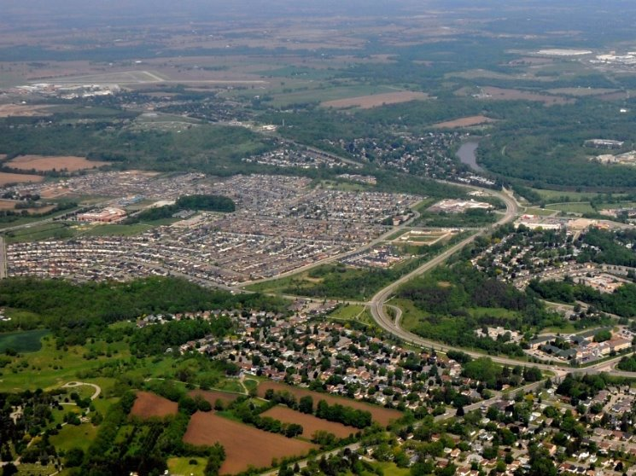
FCM: Who We Are
The national voice of Canada’s local order of government
Nearly 2,100 member municipalities in every part of Canada
60% are rural, remote and/or northern communities

Slide 4
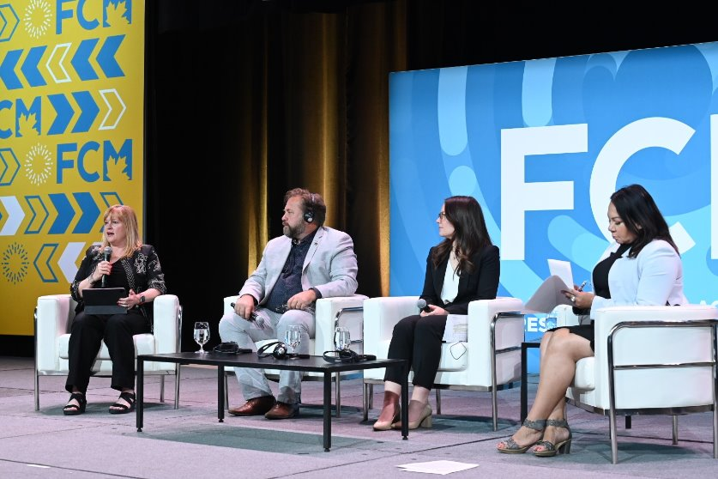
FCM: What We Do
Unite local governments of all sizes
Represent municipal interests
Connect local leaders
Build local capacity
Rural Plenary during the 2023 Annual Conference in Toronto ​

Slide 6
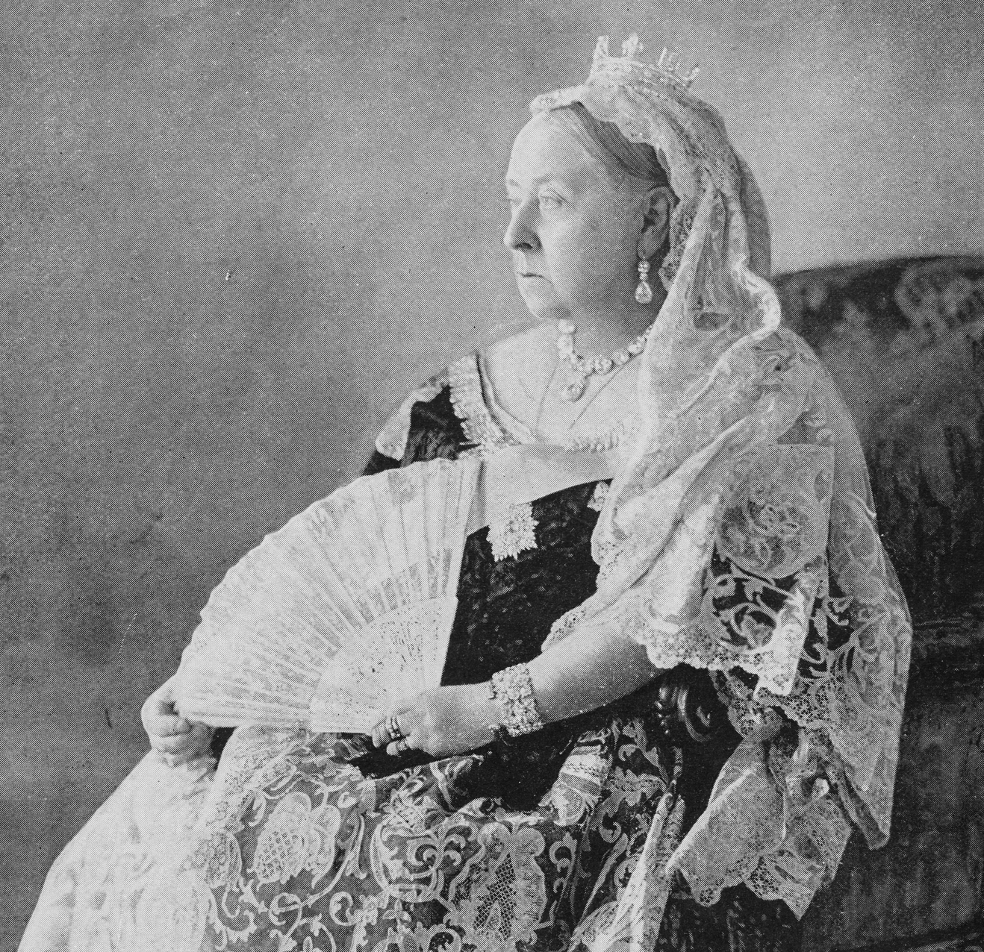
The problem: An outdated fiscal framework
The main issue with the current municipal fiscal framework is that while the responsibilities of all orders of government and especially municipalities have expanded significantly since 1867, municipal revenue has not.
The current framework governing municipal funding has not been updated since the reign of Queen Victoria.

Slide 7
The root of the problem: Over‑reliance on the property tax
In Canada, property taxes generally account for around half of all municipal revenue and nearly 90% of revenue derived from taxation.
Among OECD members, Canada has one of the highest dependencies on property tax as a share of all public sector taxation revenue (10.5%, fifth highest in 2022) and as a share of gross domestic product.

Slide 8
Year-over-year change in revenue from selected revenue sources, adjusted for inflation, 2009 to 2022

Slide 9
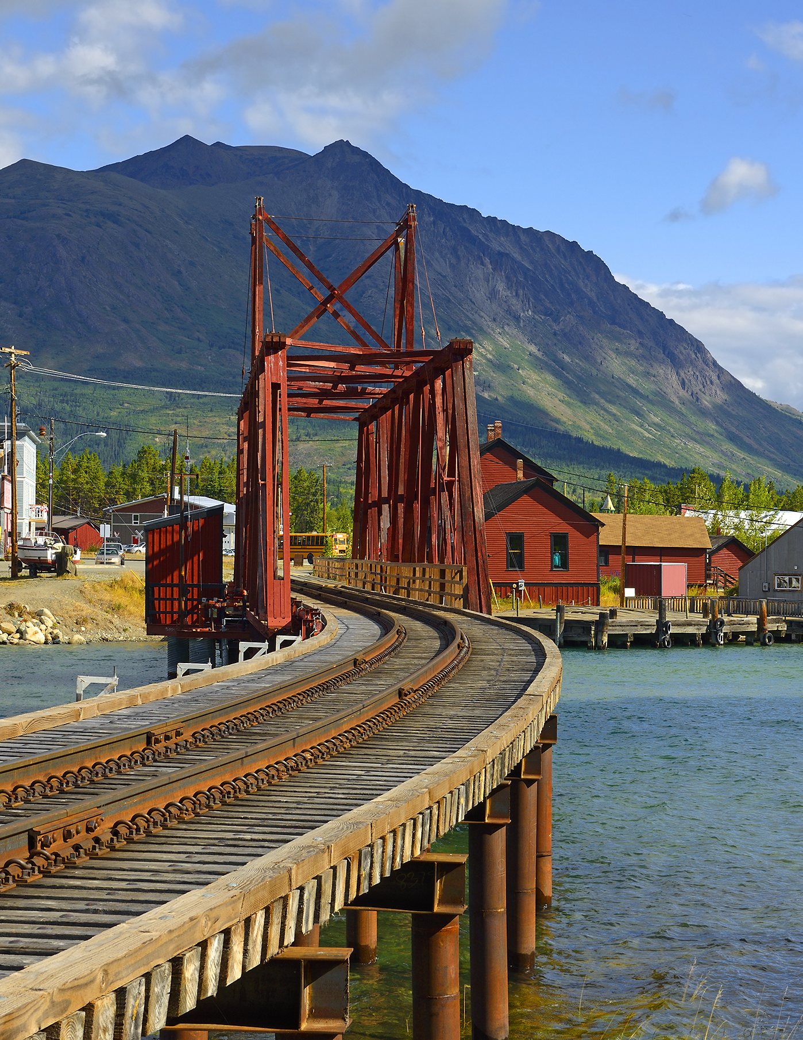
Rural and Northern
Rural and northern communities are major contributors to Canada’s GDP.
Infrastructure assets help support the economic and social well-being of our communities, but some are in poor condition.
Rural and northern Canada are experiencing rapid change: impacts from climate change, demographic shifts, etc.

Slide 10
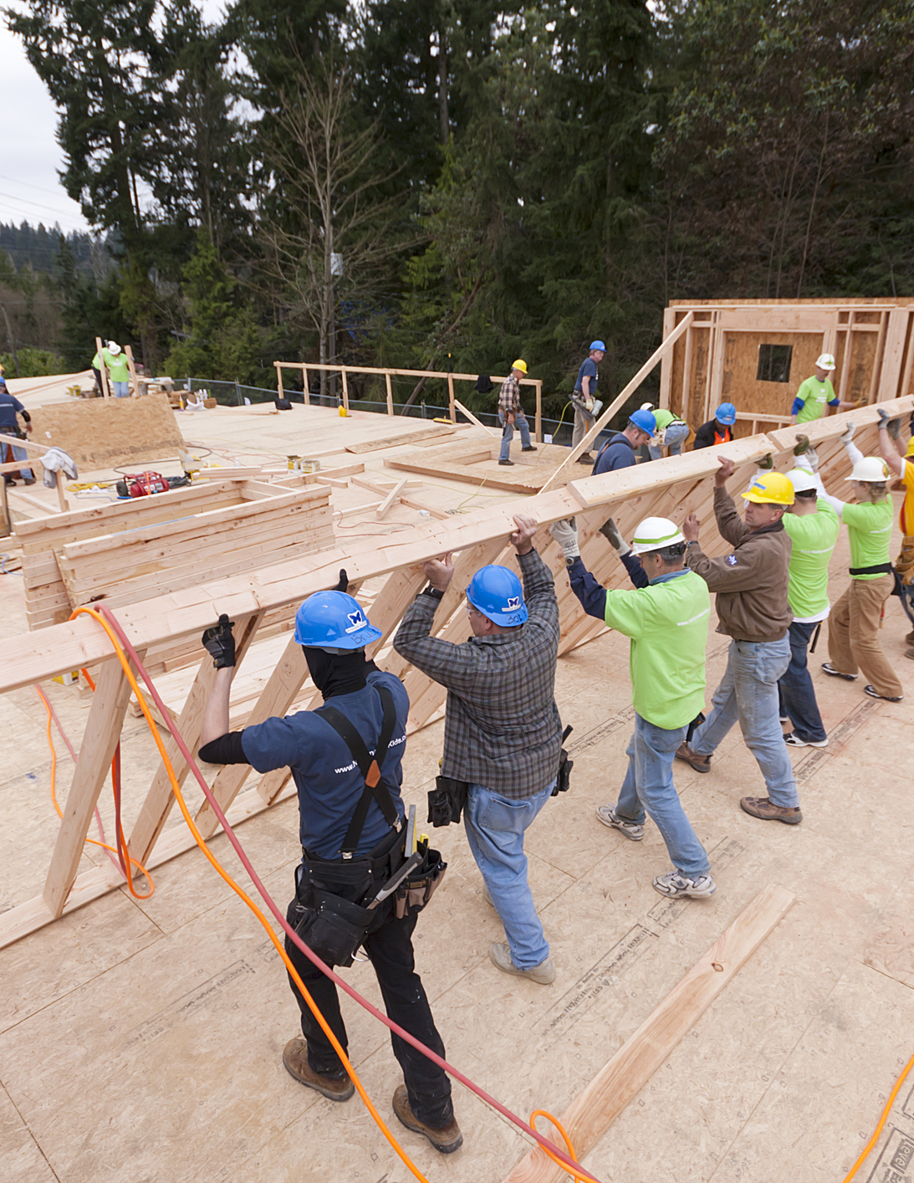
Housing, infrastructure and homelessness
We cannot build housing without the supporting infrastructure.
FCM determined that a housing unit requires an average investment of around $107,000 in municipally owned capital assets.
We need an all orders of government approach to tackle chronic homelessness.

Slide 11
Recommendations
Municipal Finance Reform
Comprehensive Plan to End Chronic Homelessness
New Municipal Growth Framework

Slide 12
Our country’s successful growth is intrinsically linked with our cities, towns and communities. That’s why Canada’s municipalities, through FCM, are calling for a new Municipal Growth Framework that empowers local governments with revenue tools that grow with Canada’s national population and economy.

Slide 13
Thank you / Merci Email: rrizzuto@fcm.ca Phone: 343-655-1998

