Slide 1
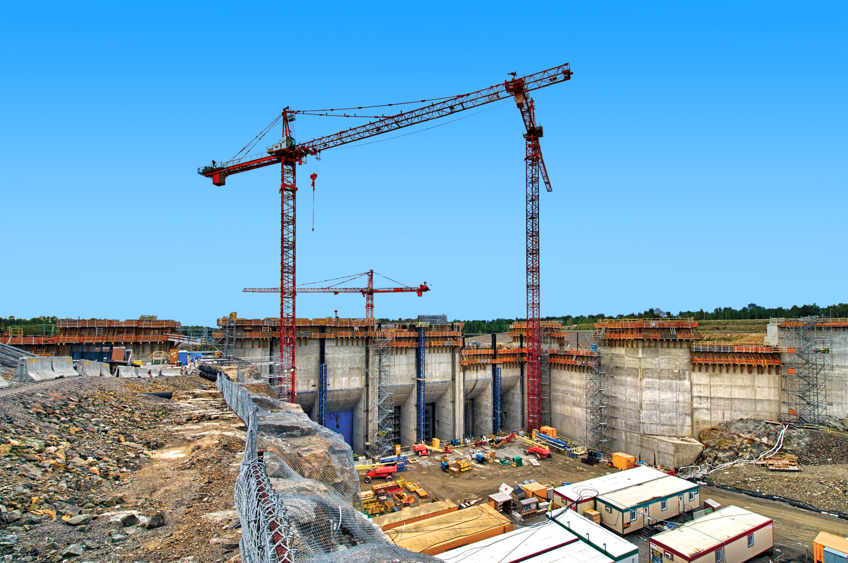
The Value of Hydro
Supporting a clean energy grid, communities, and local economies

Slide 2
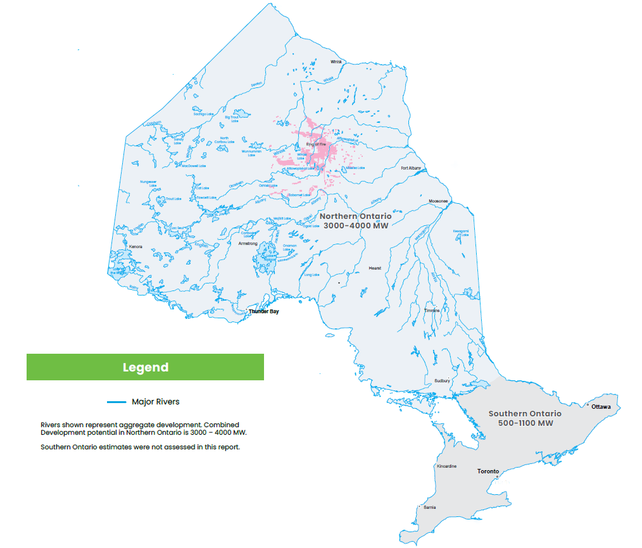
Ontario’s untapped hydro potential

