Slide 1



Northern Horizons:
Navigating Labour Landscapes in
Northwestern Ontario
Gary Christian
Executive Director
North Superior Workforce Planning Board (NSWPB)

Slide 2

Population Change NWO, 2016-2021
Population in the NWO growth 2016 (231,691) to 2021 (232,299) increased by 0.3%.
Stats Canada (https://www12.statcan.gc.ca/census-recensement/2021)

Slide 3
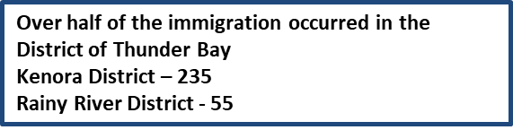
Population Growth 2016 - 2022
Immigrants Status 1,640 – Men 815, Women 830
Non-permanent residence status 3,240 – Men 1,940, Women 1,300
1000
850
812
803
800
727
647
600
558
400
Natural Change
145
200
155
200
127
121
Net Immigration Flows
0
Net interprovincial migration
-65
Net intraprovincial migration
-200
-171
-131
-160
-116
Net non-permanent residents
-188
-271
-400
-140
-267
-171
-271
-391
-307
-385
-417
-416
-445
-600
-569
-800
-672
2016/2017
2017/2018
2018/2019
2019/2020
2020/2021
2021/2022
Source: Statistics Canada (https://www12.statcan.gc.ca/census-recensement/2021) Kenora and Rainy River Districts 2022-2025 LLMP Report 2024Update

Slide 4
NWO Age Distribution
Age distribution by broad age groups.
Source: Statistics Canada (www12.statcan.gc.ca/census-recensement/2021/)

Slide 5
NWO Age Distribution Cont…
Age distribution by broad age groups.
Source (Stats Canada https://www12.statcan.gc.ca/census-recensement/2021)

Slide 6
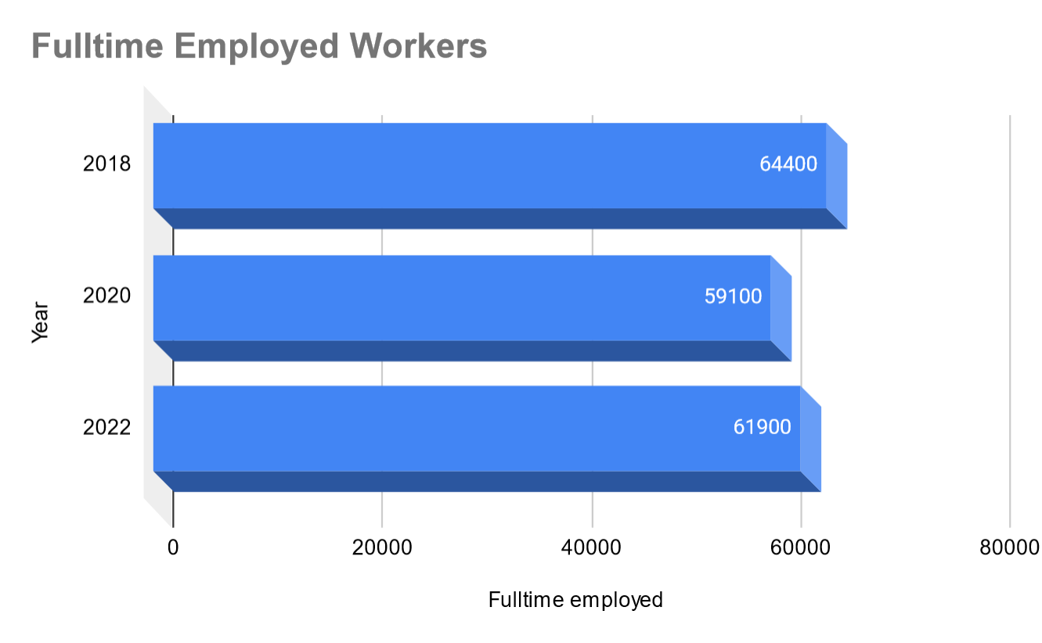
Workforce Composition
Unemployment rate in 2022 was the lowest in the last 15 years. Northwest Ontario 4.7 (2023)
Thunder Bay 4.2% (2023)
Working-Age Population
Between 2018 and 2022, the working age population decreased by 3.9% in the Thunder Bay district. However, between 2020 and 2022 increased by 4.7%.
Between 2016 and 2021, the working age population age 25 to 54 decreased 2% in the Kenora District.
Between 2016 and 2021, the working age population 25 to 54 decreased by 6.2% in the Rainy River District
Increase due to a higher number of employed full-time workers in 2022.
50,800 – the highest in the past 15 years.
Source: NPI - (Planning for Success, NSWP 2023-2024 LLMP) Kenora and Rainy River Districts2022-2025 LLMP Report 2024 Update

Slide 7








Workforce Composition
Decline in Part Time Workers
Gender Distribution of Full time Employees
53% of full-time workers
24%
47% of full-time workers
50%
50%
49%
51%
53%
47%
The number of part-time workers has deceased from 14,600 (2018) to 11,100 (2022)
M
W
M
M
W
W
2012 - 2016
2017
2022
Source: NPI - (Planning for Success, NSWP 2023-2024 LLMP)

Slide 8





Top Five Occupations in the Region
4.
Business, finance and administration
15%
1.
Sales and Service 23%
3.
Education, law and social, community and government services
16%
5.
Health
11%
2.
Trades, transport and equipment operators and related
Occupations
19%
District of Thunder Bay
2.
Education, law and social, community and government services
18%
1.
Sales and Service 22%
3.
Trades, transport and equipment operators and related
Occupations
17%
4.
Business, finance and administration
13%
Kenora and Rainy River Districts
5.
Health
10%
These occupations account for 85 % of the workforce.
Source: NPI - (Planning for Success, NSWP 2023-2024 LLMP) Kenora and Rainy River Districts 2022-2025 LLMP Report 2024 Update.

Slide 9





Gender Distribution based on occupation
Occupations with a higher percentage of men than women were:
93%
89%
85%
77%
Natural
resources, agriculture and related production
Trades, transport and equipment operators and related
Manufacturing
and Utilities
Natural and applied
sciences
Legislative
and senior management
Occupations with a higher percentage of women than men were:
78%
73%
67%
56%
54%
Education, Law, Social Community and Government Services
Business,
Finance &
Administration
Art, culture, recreation and
sport
Health
Sales and
Service
Source: Statistics Canada (https://www150.statcan.gc.ca/t1/tbl1/en/tv.action?pid=1410033502)

Slide 10
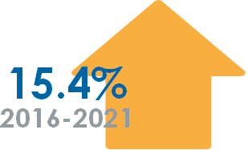





Education and Apprenticeships
The number people with a certificate, diploma or degree increased considerably by +15.4%, the highest increase among education levels.
The second highest increase during this period (+9.2%) was for high school completion.
Apprenticeship or trades certificate or diploma saw a significant decrease (-12.7%). That is part of a longer trend with, 2011 to 2016 demonstrating a decline of -16%.
Source: NPI – (Planning for Success, NSWP 2023-2024 LLMP)

Slide 11
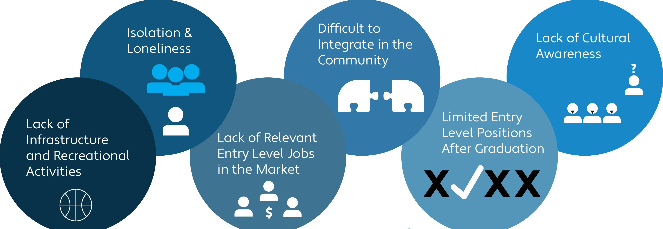
Retention of International Talent
Top Reasons International Talent is Leaving
Source: (NSWPB Talent Retention Project 2022)

Slide 12
Indigenous Workforce
First Nations, Metis and Inuit Population in NWO
There were 15,055 Indigenous people living within Thunder Bay's municipal boundaries.
Estimates place the indigenous population between 23,080 and 42,641.
Kenora District 21,575
Rainy River District 3,870
Unemployment rate amongst First Nations people is significantly higher compared non-indigenous people.
Source Statics Canada (//www12.statcan.gc.ca/census-recensement/2016 ), (Dr. Janet Smylie, Well Living House, http://www.welllivinghouse.com) Kenora and Rainy River Districts 2022-2025 LLMP Report 2024Update

Slide 13

First Nations, Metis and Inuit under-representation in the workforce
First Nations, Metis and Inuit population - 61,395 (2021)
First Nations employment rate 47% in community and 59% off community.
Inuit employment rate 55.2%.
Métis employment rate 69.1%.
(Government of Canada Parliamentary Report https://www.sac-isc.gc.ca/)
Partnerships can aid in capacity building that enable
community readiness for workforce development
opportunities
Marten Falls and Webequie First Nations, NSWPB Employment Readiness Strategy
Workforce Readiness Plan (3-5 years)
Environmental scan of community services.
Complete a labour market imitative (LMI) (Aboriginal Employment Services)
Develop training pathways.
Develop priority recommendations.

Slide 14
Future Focus
Expand labor market information for evidence-based decision-making: This lays the foundation for informed planning and allocation of resources.
Bridge employers, workforce resources, and students/newcomers: Connecting these stakeholders fosters employment opportunities and economic growth.
Align post-secondary institutions with labor market needs: Ensuring education programs match industry demands improves workforce readiness.
Strengthen pathways from high school to post-secondary education: Facilitating smooth transitions enhances educational attainment and future employability.
Collaborate with Indigenous organizations: Partnering with Indigenous groups promotes inclusivity and addresses unique needs and perspectives.
Provide training and education options for First Nations, Métis, and Inuit peoples: Supporting educational opportunities for Indigenous communities promotes equity and economic advancement.
Support organizations during system changes (e.g., policy updates): Offering assistance

Slide 15
Thank you!
Merci!
Miigwetch!

Slide 16
Contact Information
Gary Christian Executive Director
North Superior Workforce Planning Board gchristian@nswpb.ca (807) 346-2943 (807) 633 3194

