Slide 1
Delivering on Our Mandate—and Beyond
Northwestern Ontario Municipal Association
2024

Slide 2
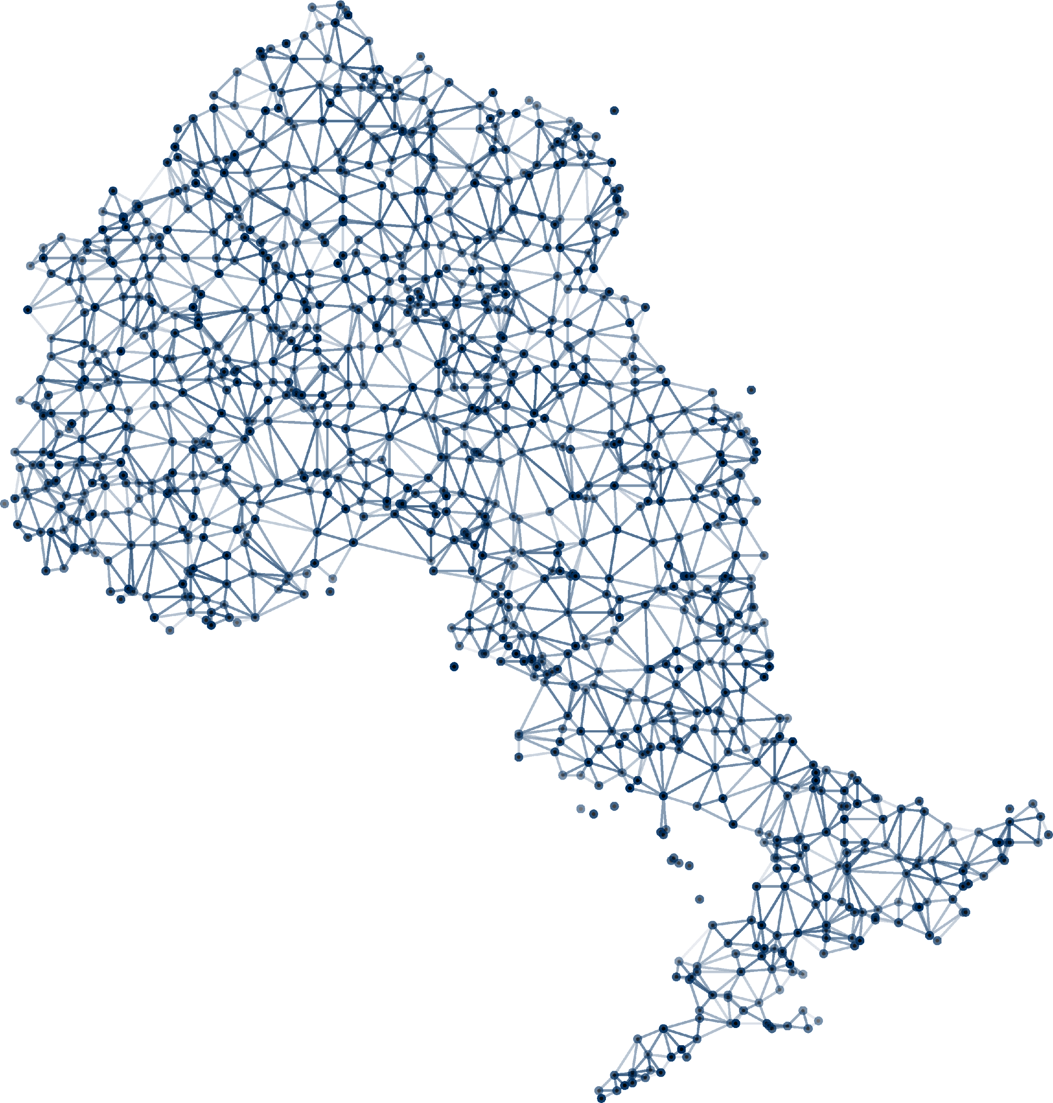
Territory Acknowledgement
We gratefully acknowledge the Elders and Knowledge Keepers who share their gifts and teachings with us so that we may better understand and honour their wisdom, and that of all Traditional Keepers of this land.
NOSM University will continue to practice reconciliation by listening, learning, and fostering a culture of mutual respect and trust.

Slide 3
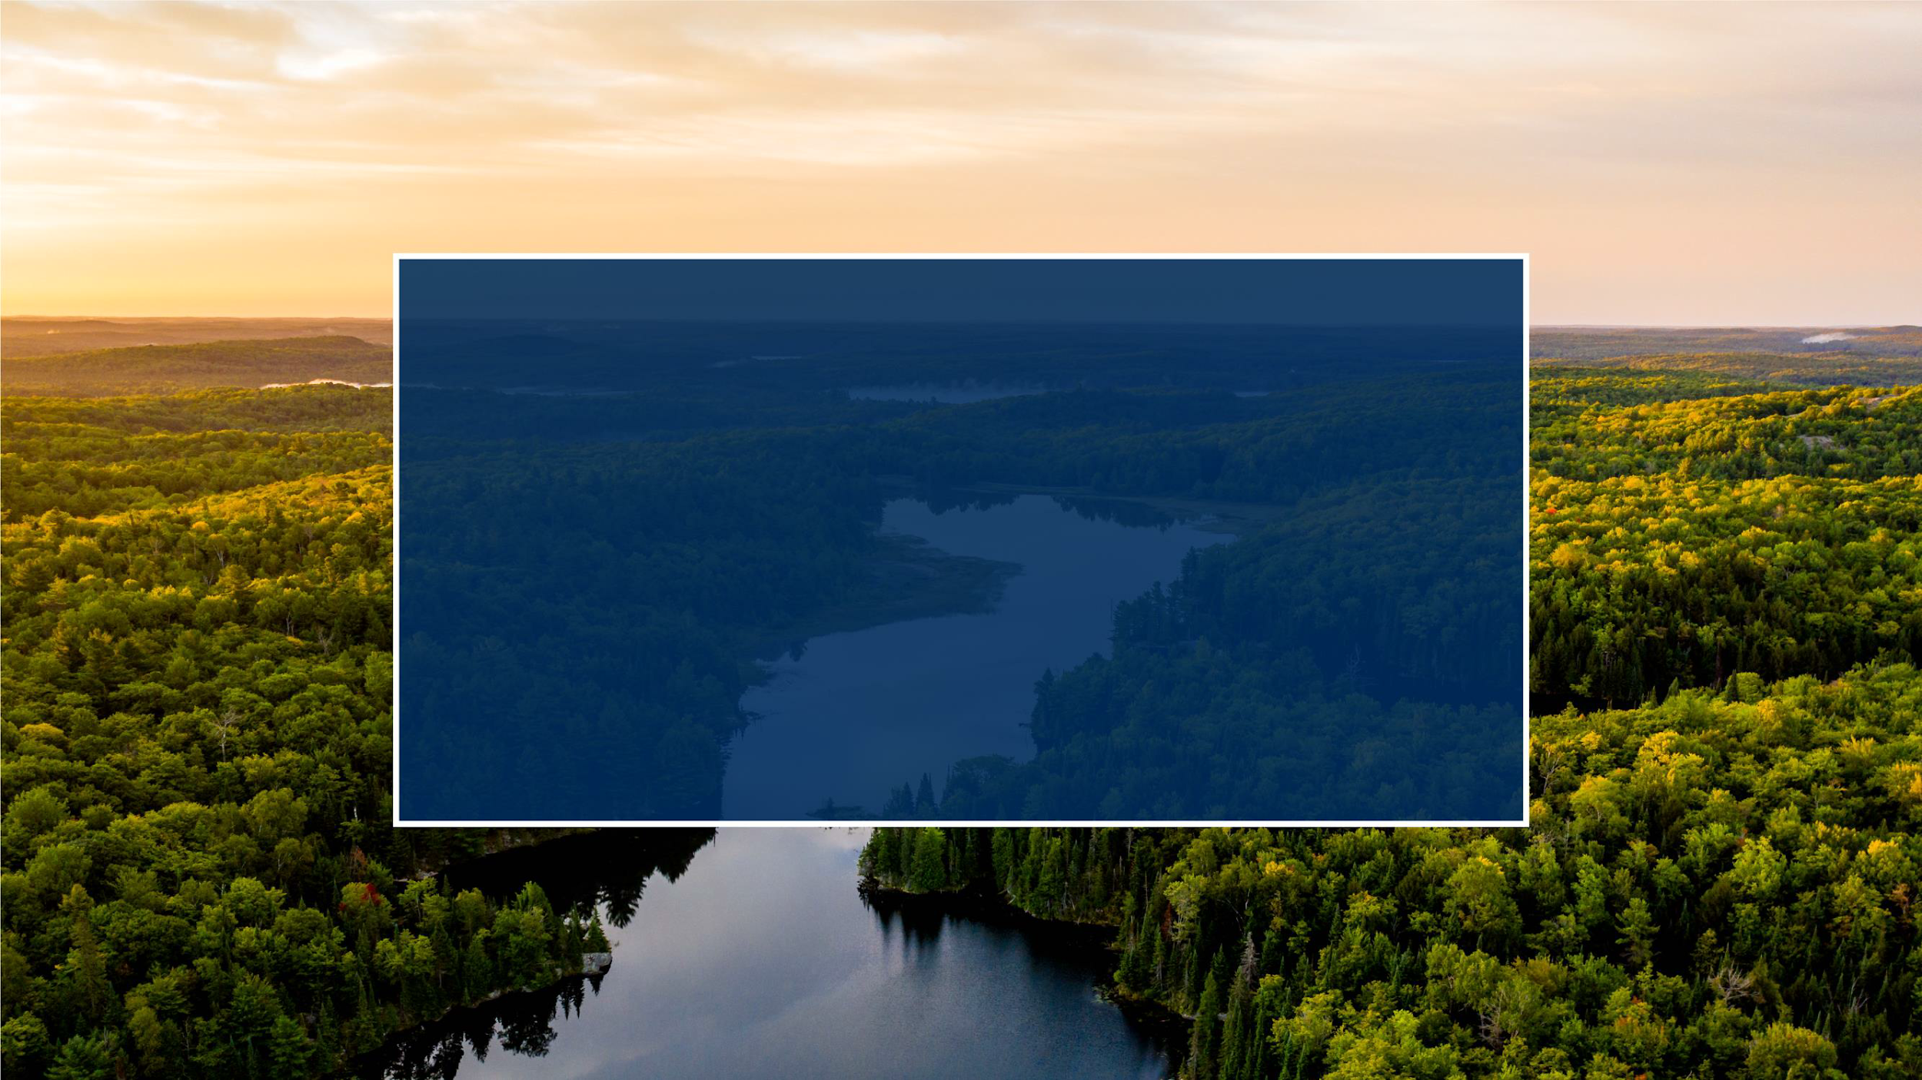
Mission
To improve the health of
Northern Ontarians by being socially accountable in our education and research programs and advocating for health equity.
5
Notes:
Our mission:
To improve the health of Northern Ontarians by being socially accountable in our education and research programs and advocating for health equity.
Under our legislative Act, our Special Mission is as follows:
It is the special mission of the University to provide programs that are innovative and responsive to the needs of individual students and to the unique healthcare needs of the people of northern Ontario and other northern regions of Canada, which includes people living in rural, remote, Indigenous and Francophone communities.

Slide 4
Who We Are
Notes:
Many of the people here know us well, but for those who are new to the table, a brief overview.

Slide 5
One of Canada’s Greatest
Health Human Resource Success Stories
Notes:
Put simply: we are one of Canada’s greatest health human resource success stories.
The Northern Ontario School of Medicine (NOSM) was established in 2002 as a key government strategy to reverse the chronic physician shortage in Northern Ontario.
Some twenty years later, the Northern Ontario School of Medicine University Act was proclaimed into force on April 1, 2022, making us Canada’s very first independent medical university—NOSM University.
With a massive expansion of medical programs also announced in 2022, a new Board of Governors and Senate, plus an inaugural Chancellor, there is considerable momentum behind NOSM University, the destination of choice for people hungry for transformation in health care.
And that is a transformation that is sorely needed in the North.
It’s hard to imagine, but statistically, the roughly 800,000 people in the North will live shorter, less healthy lives than people in the south.
As Canada’s first-ever independent medical university, NOSM University is doing everything it can to help educate doctors and point them in the direction of where they’re needed most.
Did you know?
Independent legal entity (not-for-profit corporation) since 2002
Provincial funding flows directly to NOSM University (no longer affiliate with Laurentian or Lakehead Universities)
Fully accredited, develops and delivers its own curriculum and grades its students for graduation
Employs its own staff and faculty (225 split 50/50 in Sudbury and Thunder Bay) including its own staff and faculty unions
Manages close to 1,800 clinical faculty contracts across the North (the NOSM University campus)
Provides its own administration (Human Resources, IT, Finance, Communications, Research and Libraries, etc.)

Slide 6
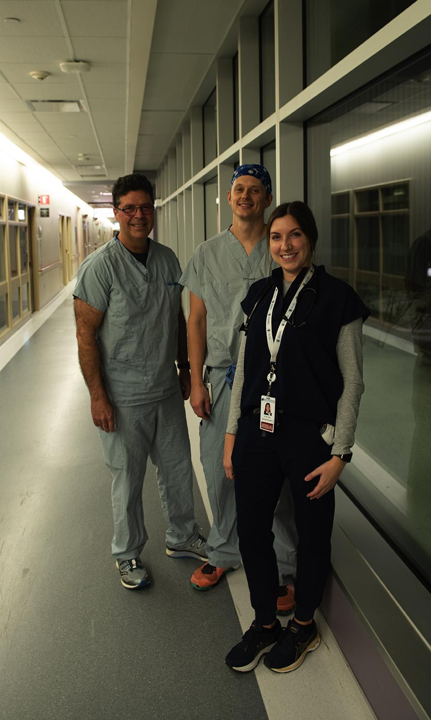
Tracking our Graduates
Sault Ste. Marie
902 MD graduates—73 Indigenous and 179 Francophone
827 physicians have completed training in NOSM University’s residency programs
197 Registered Dietitians have completed their program
55% are practising in Northern Ontario, including 100% of the 2022 graduates.
Notes:
NOSM University is delivering on its mandate.
So far, not including the 2024 cohort, NOSM University has graduated 902 MDs—73 Indigenous and 179 Francophone.
We know that more than half of NOSM University graduates have stayed in Northern Ontario.
Today, more than 400 family doctors, trained at NOSM University and working across the North, have enrolled over 400,000 Northern patients—half of the population of Northern Ontario.
In addition to an MD program and postgraduate medical education, NOSM University offers opportunities including:
A dietetic internship program (NODIP)
A rehabilitation sciences program in which learners from Audiology, Occupational therapy, Physiotherapy and Speech-Language Pathology programs at our partnering universities apply through their home program to complete a clinical placement in Northern Ontario.
A medical physics residency

Slide 7
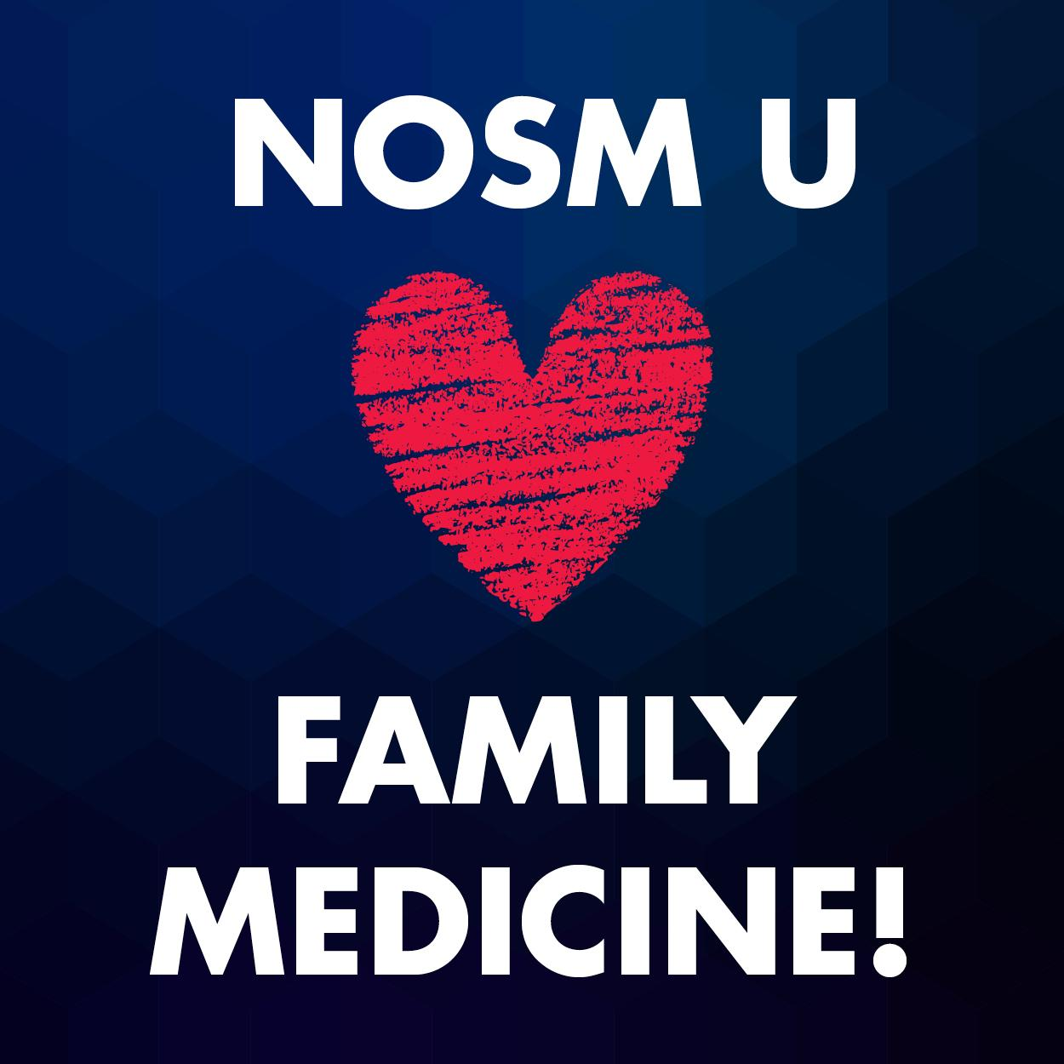
55% of first-round MD graduates chose Family Medicine in 2024.
National Canadian average (30.3% in 2023).
Notes:
At a time when access to family doctors is a priority for many Canadians, our grads are hearing the call.
More than half of first-round MD graduates at NOSM University chose family medicine—higher than the Canadian average → (30.3% of CMGs selected Family Medicine as their first choice discipline (CaRMS 2023 Annual report)
The other terrific news is that 50% of our graduating MD class is staying to do a residency in Northern Ontario, which is a huge win, especially if you consider that close to 90% of learners who do both an MD and a residency in the North stay in the North.

Slide 8
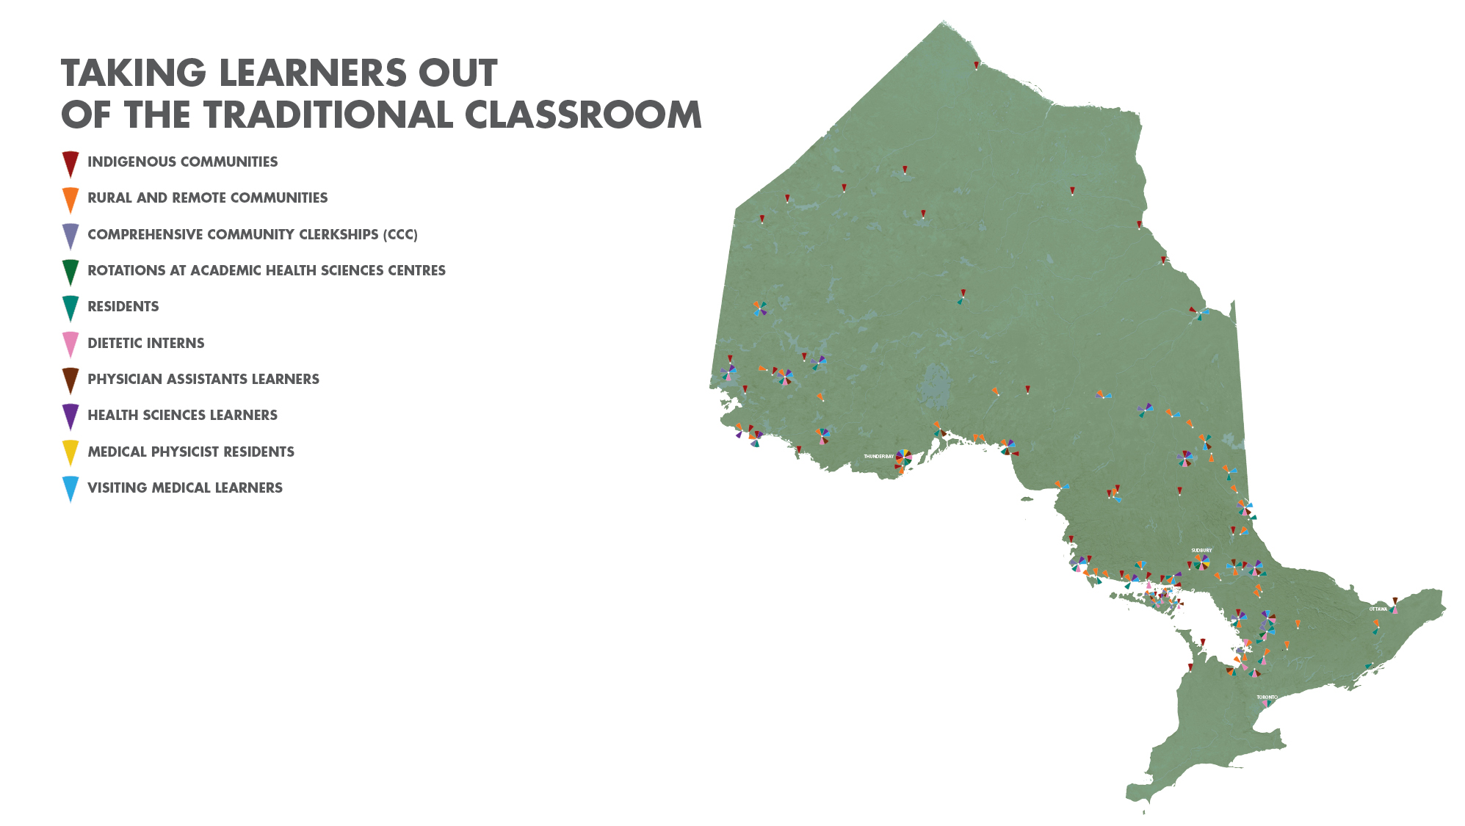
Independent Medical University
Notes:
What makes our model so successful?
Our unique distributed, community-engaged learning or D-C-E-L model has grown into something extraordinary, and is recognized on an international level.
Almost 90% of learners who complete both undergraduate and postgraduate training at NOSM University remain in the North, including 28% in rural or remote communities.
That’s in part because this model includes strong ties and engagement with remote, rural, Indigenous and Francophone communities.
It also features partnerships and collaborations with more than 500 organizations, in 90-plus communities, and with more than 1,800 clinical, human and medical sciences faculty dispersed across all of Northern Ontario.
Interesting to note when looking at this map (which shows the concentration of medical schools in southern Ontario):
There new medical schools are on the horizon in Ontario and beyond.
In Ontario, we’ll see a new medical school at Toronto Metropolitan University (formerly Ryerson); and York University’s medical school has just been announced by the province.
Simon Fraser University in British Columbia has been approved to go forward.
In the east, Cape Breton University is developing a proposal for a medical school, and so too is the University of PEI.
NOSM University’s model is being studied in this context.

Slide 9
Context

Slide 10
What is the Need for Physicians?
Currently across Northern Ontario we need at a minimum:
384 full time equivalent physicians
More than half family physicians (including 110 Rural Generalists)
We need 180 Royal College specialists in a variety of disciplines with the highest numbers in:
Psychiatry
General Internal medicine
Pediatrics
Emergency medicine (CCFP EM or FRCPC)
Anaesthesia
Obs/Gyn
We also need small numbers in plastic surgery, respirology and neurology, and even though the numbers are small, some of these are critically important to service delivery and so are in “high need.”
*Data from June 2023
Notes:
We all know this from ongoing news coverage, but the need for physicians is significant.
These are the numbers as NOSM University understands them today.

Slide 11
Our Plan

Slide 12
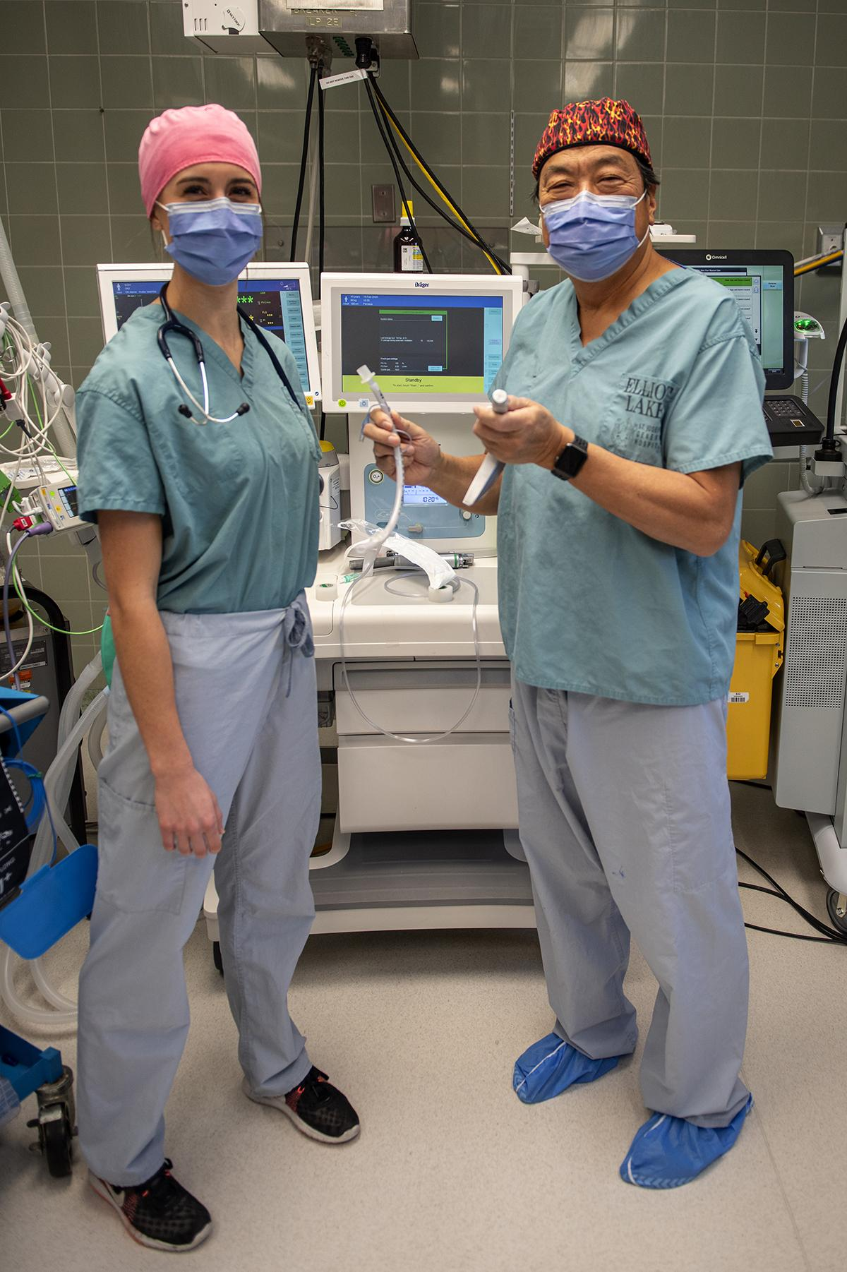
Poised for Expansion
Elliot Lake
Expansion is taking place steadily until 2028:
UME is increasing from 74 in 2022 to 108
PGME is increasing from 60 in 2022 to 123
Notes:
Here’s how we can help.
The anticipated expansion of NOSM University to almost double its undergraduate and postgraduate capacity over the next five years will bring in added revenue and more doctors to the North.
We expect to increase our MD program intake from 64 to 108 spots by 2028—almost doubling the size of our class.
Residency spots are also increasing from 60 to 123.
This is terrific news for Northern Ontario, as our retention rate is very good.
However, it’s not as simple as “flipping a switch.”
With expansion of this magnitude, NOSM University is now working hard to address capacity issues including securing additional faculty and increasing the availability of required clinical spaces for learners (especially in a competitive environment).

Slide 13
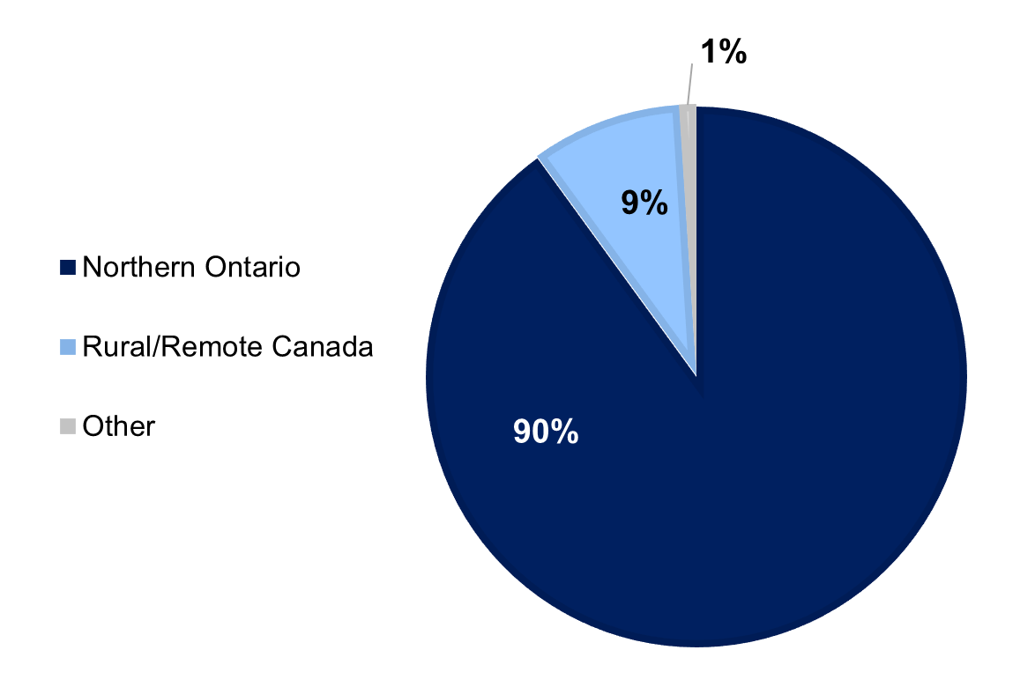
Who gets in to NOSM University?
Notes:
People often ask, “Why not just take more students?”
The truth is, we cannot take everyone who applies, even those who are eminently qualified. The province caps admission.
Just the same, there also seems to be a misconception that many Northern students are not getting into our MD program.
That is simply not true.
Since 2006, 1,038 of the 1,152* or 90% of all applicants admitted to NOSM University’s MD program have been from Northern Ontario, or have had significant living experiences in Northern Ontario.
An additional 9% of candidates were from rural or remote areas in the rest of Canada, including southern Ontario.
The admissions process is intentionally designed and weighted to favour Northern applicants.
(*The total number of admitted learners is 1208. However, the Office of Admissions does not have demographic data for the 2005 cohort. Therefore, the numbers above are based on admitted learners from 2006 to current.)

Slide 14
Context Score
Factors that are considered assets to admissions
Rural Background
Indigenous
Francophone
Service to the North
Northern Background
Notes:
GPA isn’t the only factor that matters.
NOSM University aims to admit a class that is reflective of the demographics of the population of Northern Ontario.
That includes the commitment to recruiting Indigenous and Francophone students as well as those with a strong desire to live and work in Northern Ontario or rural and remote areas in the rest of Canada.
Admissions uses something called the Context Score as a part of it’s metrics.
The Context Score is based on each of the following geographic or cultural criteria:
1. Northern background is based on years lived in Northern Ontario or another Canadian northern region.
2. Rural background is based on years lived in a rural community anywhere in Canada, defined using Statistics Canada classification of communities.
3. Indigenous applicants who apply through the NOSM University Indigenous Admissions Application Stream and receive approval from the Indigenous Admissions sub-committee.
4. Francophone applicants who apply through the NOSM University Francophone Admissions Application Stream and receive approval from the Francophone Admissions sub-committee.
5. Employment experience serving the populations of Northern Ontario and/or rural and remote communities of Canada.
And of course, evidence of commitment and sustained experiences in the North is considered an asset.

Slide 15
“Someone I know didn’t get in”
YEAR | TOTAL APPLICATIONS | INTERVIEWED | MD SEATS AVAILABLE | % ADMITTED OF TOTAL APPLICATIONS | AVG. GPA (4.0 SCALE)
2023 | 1,692 | 332 | 79 | 4.6 | 3.78
2022 | 1,710 | 334 | 74 | 4.3 | 3.81
2021 | 1,975 | 335 | 69 | 3.5 | 3.82
2020 | 1,727 | 322 | 64 | 3.7 | 3.86
2019 | 2,003 | 312 | 64 | 3.2 | 3.86
Notes:
This is something we also hear from people.
Things to note:
The MD admissions process is extremely competitive, and again, enrolment is capped by the province.
Even elite scholars sometimes don’t get in to the program.
There are a number of factors we consider, including GPA.
The minimum required overall GPA is 3.0 on the 4.0 scale.
But while 3.0 meets the minimum bar for admission consideration, given the rising level of competition for a limited number of positions, a higher GPA gives you a more reasonable chance of admission.
Over the past ten years, the average GPA for NOSM University’s entering MD class has been 3.82.
Look at this chart:
Over the last five years, we have received an average of about 1,420 applications for between 64 and 79 MD seats.
Of the total applications to the University in 2023, 4.6% were admitted.
The average entering GPA at NOSM University over the last 10 years has been 3.82 on a 4-point scale.

Slide 16
The 3.0 GPA
Minimum to even consider an application
Life circumstances as a factor (ex., life-altering event)
Acknowledgement that people in the North often have fewer education and preparatory opportunities than those in larger, mainly southern areas
Notes:
So, why would NOSM University tell people they can apply with a 3.0 GPA when the GPA of those selected is closer to 3.8?
Foremost, this is the minimum GPA to simply open up a file for consideration.
The rationale is that we want to “cast a wide net” to include for consideration those who may in fact be excellent doctors, but whose life circumstances have made a higher GPA out of reach.
GPA ends up being about a sixth of the overall score assigned to an application.
The context score and interview process gives us additional information to help us better understand the potential of an applicant.
Consider that ultimately, admissions obligations are as follows:
To ensure the best overall candidates are selected for admission
To champion those candidates who are likely to thrive in the challenging Northern and rural learning environments
To set students up for success through the admissions process
To safeguard NOSM University’s reputation as an institution of the highest quality and standards

Slide 17
What Can You Do to Attract Doctors?

Slide 18
Role of the Communities
Collaborate with other Northern communities to become truly competitive in the market for physicians
Make your community attractive to work and live
Housing, attractive schools, jobs for spouses, turnkey offices and lifestyle
Successful recruitment requires:
A well-organized and effective recruitment team
Competitive offers (e.g. turnkey operations)
Strategic planning for success in practice development
Sensitivity to the needs of the new hire
Investment is worth it: doctors bring in jobs, taxes, other health-care professionals and economic drivers
Notes:
NOSM University can select for qualified applicants who are likely to stay Northern Ontario, but we cannot make them stay
NOSM University cannot dictate where graduates go after graduation
In fact, there is no structure under which a doctor is assigned to any community—no “return of service” guarantee
It also takes a long time to educate a doctor. We can only graduate so many a year. After a student graduates with their medical degree, they have postgraduate training to complete which can be anywhere from 2 to 9 years depending on whether one chooses family medicine or another specialty like internal medicine, general surgery, pediatrics, psychiatry or a subspecialty area of practice.
It would take five graduating classes from NOSM University just to fill the current demand in Northern Ontario.
BIG PICTURE:
Canadians still report being unable to find a family doctor everywhere.

Slide 19
Role of the Communities
Be a teaching community; work with your physician group to host students and residents
Welcome both NOSM University learners and elective learners from other institutions
Understand that “word of mouth” among learners is your best marketing strategy; treat every learner as though they may be your next recruit

Slide 20
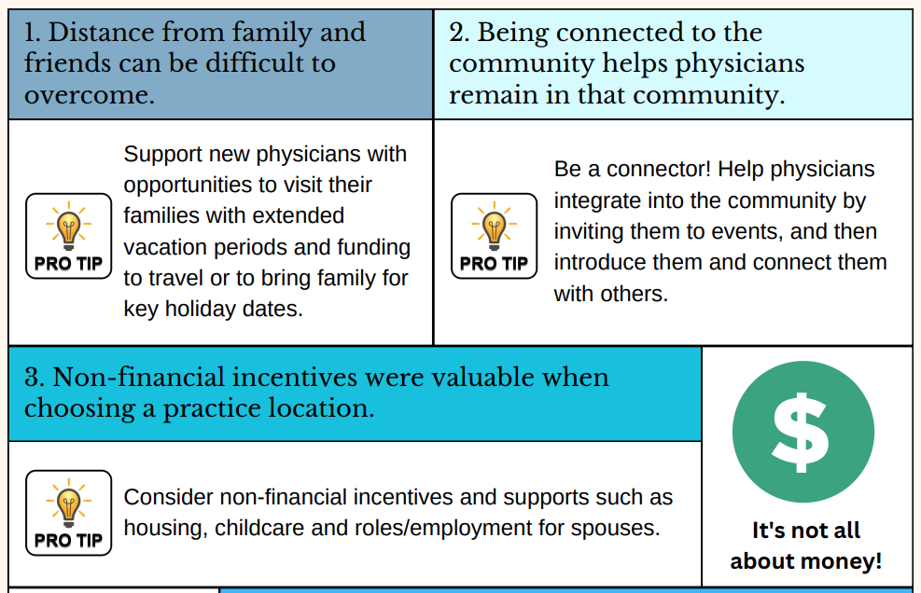
Best Practices for Recruiters Welcoming New Physicians
https://www.nosm.ca/wp-content/uploads/2023/12/Recruiter-Infographic-V3.pdf
Notes:
We have some ideas to help.
This is from the Physician Workforce Strategy folks at NOSM University.
They interviewed 18 family physicians in their first 5 years of practice to understand what it was like to start their careers in Northern and rural areas. Here is what they learned.
Best practices among successful recruiters (see slide)

Slide 21
Best Practices Continued
https://www.nosm.ca/wp-content/uploads/2023/12/Recruiter-Infographic-V3.pdf
Notes:
Visit the NOSM U Physician Workforce page:
N. Ontario Physician Workforce Opportunities & Resources | NOSM U

Slide 22
Ouimet Canyon
Reality Check
Primary care doctors are under immense pressure
Studies of the physician workforce in Canada show that younger physicians today do not work the same hours or bill the same volume of services that their older counterparts did in the past
Gender, age, and boutique practices have an impact
The COVID-19 pandemic and burnout mean about 50% of aging doctors may retire in next five years
It is a buyer’s market

Slide 23
What is your community doing to attract new doctors?
Notes:
We have a question for you…

Slide 24
What’s the outlook for
NOSM University?

Slide 25
Financial Sustainability
OPERATIONS FIDUCIARY RESPONSIBILITY
ADMINISTRATION MANDATE
Notes:
The outlook is very positive.
It is a balancing act but we are well-positioned for success
While we are experiencing the financial growing pains becoming an independent university, and that of expansion…
… we have still managed to balance operations and administration while balancing fiduciary responsibility with the ability to deliver our unique mandate

Slide 26
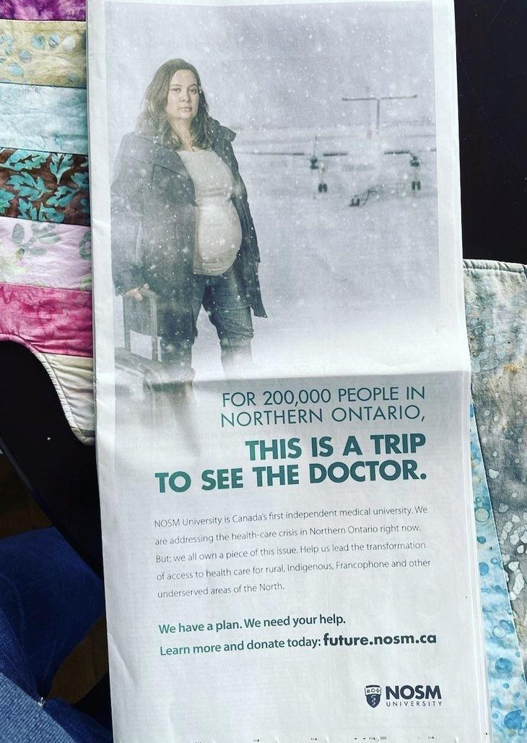
Financial Investment
Optimistic: $4 million boost in base funding from province
Fundraising: Achieved the First $50 million in NOSM U Student Endowment Fund*
Visit www.report.nosm.ca for more information.
*Since May 2022
Notes:
NOSM University has enjoyed very strong support from the Northwestern Ontario Municipal Association (NOMA) and communities across the region
Because of that ongoing advocacy, in part, we are optimistic that the province will agree to our base funding request of $4 million
We were able to make that case because of the tuition freeze in place since 2019, capped enrollment, the cost of inflation, the costs of expansion, and much more, we need a boost of $4 million to continue to deliver on our mandate.
However, it is clear that the province also knows that in terms of return on investment as a government strategy, we’re a terrific deal with an unparalleled return
The Future Will See You Now campaign, here a full-page spread in the Globe & Mail, has raised millions. Since May 2022, NOSM University setout to create a $50 million endowment fund to support NOSM University learners and offset tuition cost.
Our students graduate with nearly twice the debt of students at other medical schools in Canada. It’s not because we’re more expensive: it’s because we recruit from the North, for the North, and typically, people in the region don’t have access to the same financial and social means as students in the south.
We have achieved this and are planning for another $50 million campaign to support our students and our critical mission.
Landmark donors (some from southern Ontario) have given millions, including FDC Foundation and the Temerty Family Foundation.

Slide 27
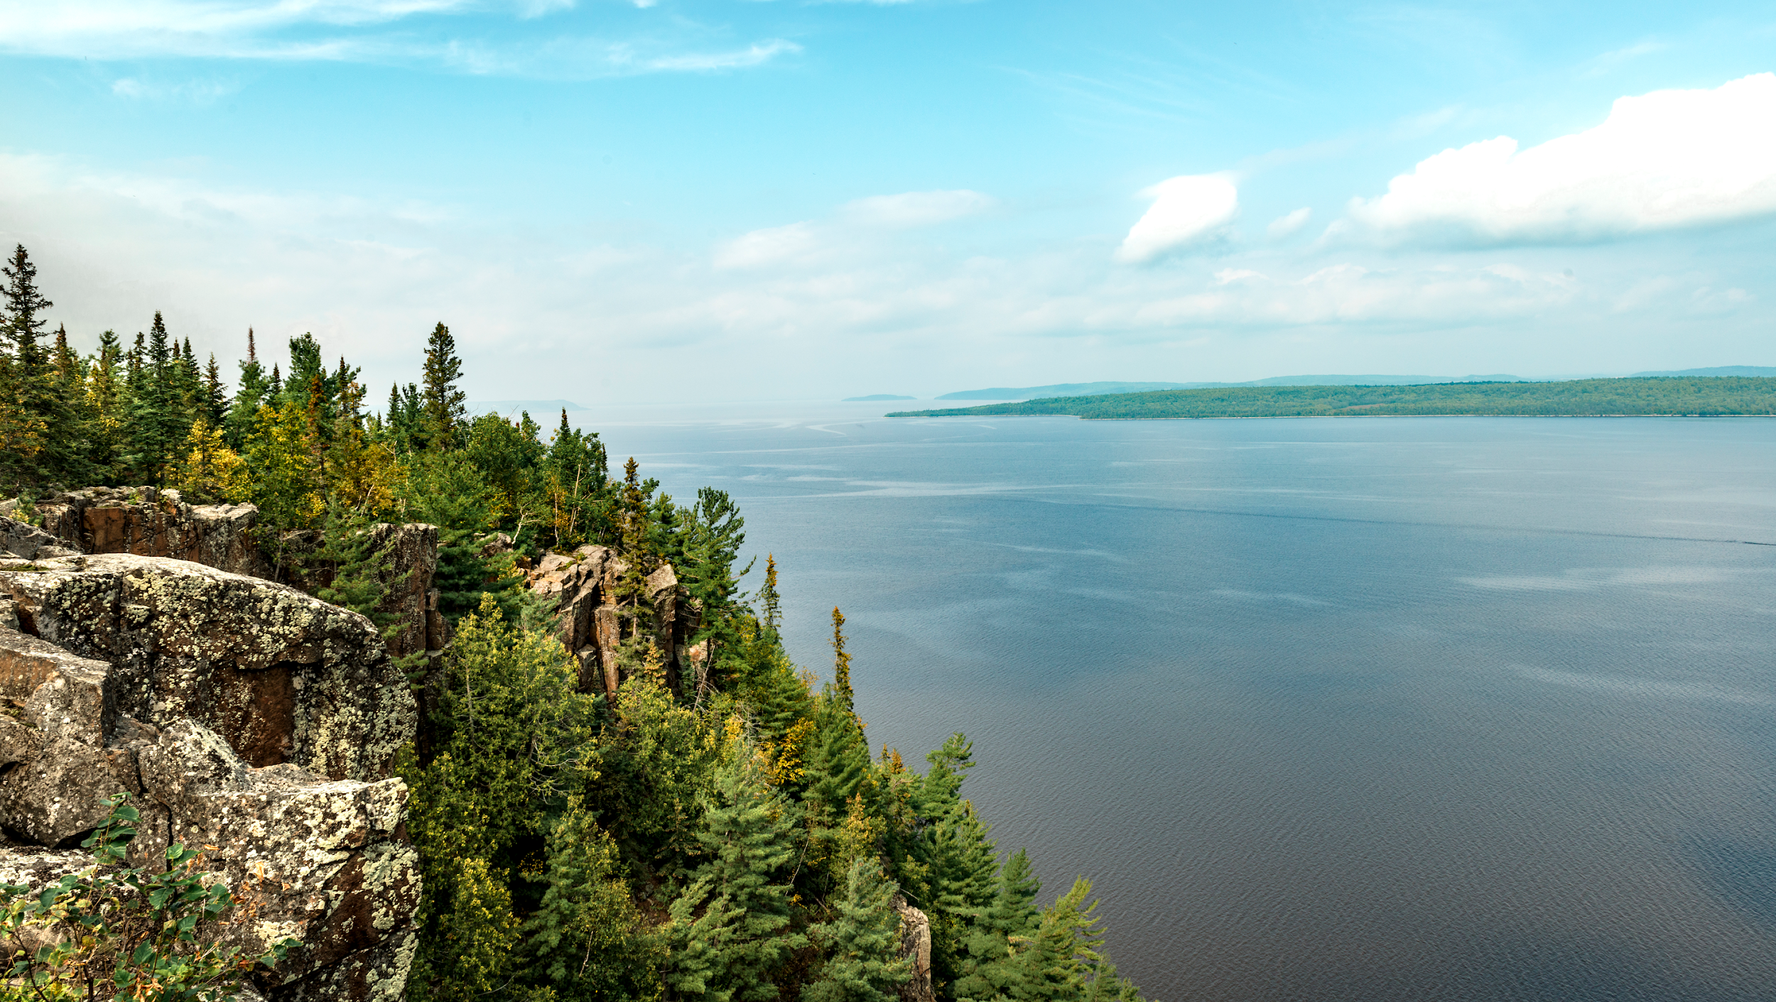
Thank You, NOMA!
Thank you for supporting NOSM University and health equity in Northern Ontario
Notes:
Collaboration opportunities

Slide 28
Questions

Slide 29
future.nosm.ca
Notes:
We know for a fact that what we are doing is working.
I’ll re-cap:
We have graduate almost 1000 doctors, and about 400,000 people in the North have been helped by one of them so far.
More than half of our 2024 MD graduates chose a family medicine residency as their first choice–higher than the national average (55% family med)--compare with other schools
About 50% of our 2024 grads are staying in the North for their residency, greatly increasing the likelihood that they will stay in the North
We have nearly raised $25 million toward our burgeoning Student Endowment Fund
Through advocacy by organizations like NOMA, the province has made funding commitments that will put us on stable financial footing.
The future is bright at NOSM University!

