Slide 1
The Power of Partnerships
April 25th, 2024
Carol Cline, Dean Workforce Development
Confederation College

Slide 2
Confederation College is primarily funded by Ministry of Colleges and Universities
The College has 8 regional campuses
Delivers exceptional training to an average of 7800 combined full and part time students
Offers over 60 programs and course: business, multimedia, hospitality, health, community services, engineering technologies, trades and aviation
The College values a learner-centered approach
Over 40 years of experience in the management of large scale, multi-million-dollar training, education and development projects
Notes:
Confederation College has several Partner advisor committees to inform Post Secondary programs and courses – significant changes to programs can be a bit challenging as the MCU, MILTSD has long processes
Contract Training division of the college can address the changing needs of industry and be instrumental in proof of concept for program changes,
partner with communities, industries and municipalities to access funding to meet the labour needs, we have been partners in applications for Employment and Social Development Canada, Ontario training funds such as Skills Development Fund and Skill Advance Ontario.

Slide 3
Guiding Principles
Innovative projects built in partnership
Equity, transparency and sharing
Support socio-economic development within communities
Core belief on healthy sustainable communities
Notes:
No training for the sake of training, purposeful, meaningful and must meet the need of the community and the individuals in the community
The college in committed to training based on strategic goals that create a pathway to meaningful employment and opportunity in the communities
Along with ensuring the individual community members have Personal pathways
East West Tie
Mining consortium along the eastern shore
Forestry consortium meet the needs of the forestry industry in the Northwest
Resolute partnership with Forestry truck drive contractors
Equinox/Greenstone Gold

Slide 4
Innovation
Relationship development, collaboration and partnering
Community-based approach engage community members in skills training leading to sustainable employment opportunities
Deliver skills training programs that align with industry needs and emerging economic opportunities
Performance management framework with formative evaluation to support continuous improvement
Notes:
Key first step is relationship building this can take a significant amount of time to build trust and understanding, commitment to this prior to funding or training: Example
Our partnerships with Greenstone Gold (Equinox) and the communities connect were developed over 5 years leading up to the start of construction, this is done at no cost to the community or industry as it relates to the role the community college plays in Northwestern Ontario and it speaks to understanding the partners
College has significant deliverables and contracts with the community, establish what is needed to support the project in community add the financial resources into the applications, equipment tools purchased with funds for community and or individual – ensure that the community has the proper positions built into the contract – wrap around supports and services are often provided in community through a funded position

Slide 5
Sustainability
Transferable skills to other locations, employers and sectors
Community-based investments for self-employment opportunities
Identifying training opportunities that best position the community for best practices, model transfer and project leadership
Notes:
In partnership with community/economic Development etc. we complete comprehensive intake and assessments, this provides the individual trainees with an understanding of their training and learning journey and it provides the community and industry with a baseline to understand the training pathways required to develop a competent workforce that can be retained
Balancing act between community need and individual need with industry need. Example construction: flagger needs to be able to progress through to other jobs, it is the job of the educational institution to advocate and ensure the individual has opportunity
Develop individualized education plans for trainees
Ensure that the skills are transferrable with multiple career pathways, meeting company need but also ensuring that the path is not short sited

Slide 6
Industry-Driven Skilled Workforce
Collaborative and innovative development and delivery of employment strategies
Industry Alignment
Community capacity and improvement
Notes:
Our main goal as the contract training College department is to ensure that we are working to create an industry driven workforce, we are able to influence training delivery and funding to ensure that there is adequate wrap around supports and services for the community and individuals, and that we leave the community/municipality better than when we began the training.
We have a model that mentors, supports and creates infrastructure for communities, build capacity to apply for and administer training contracts in the future, currently the college takes on a number of roles when training strategies are applied for and mobilized
Examples of our training priorities next slide

Slide 7
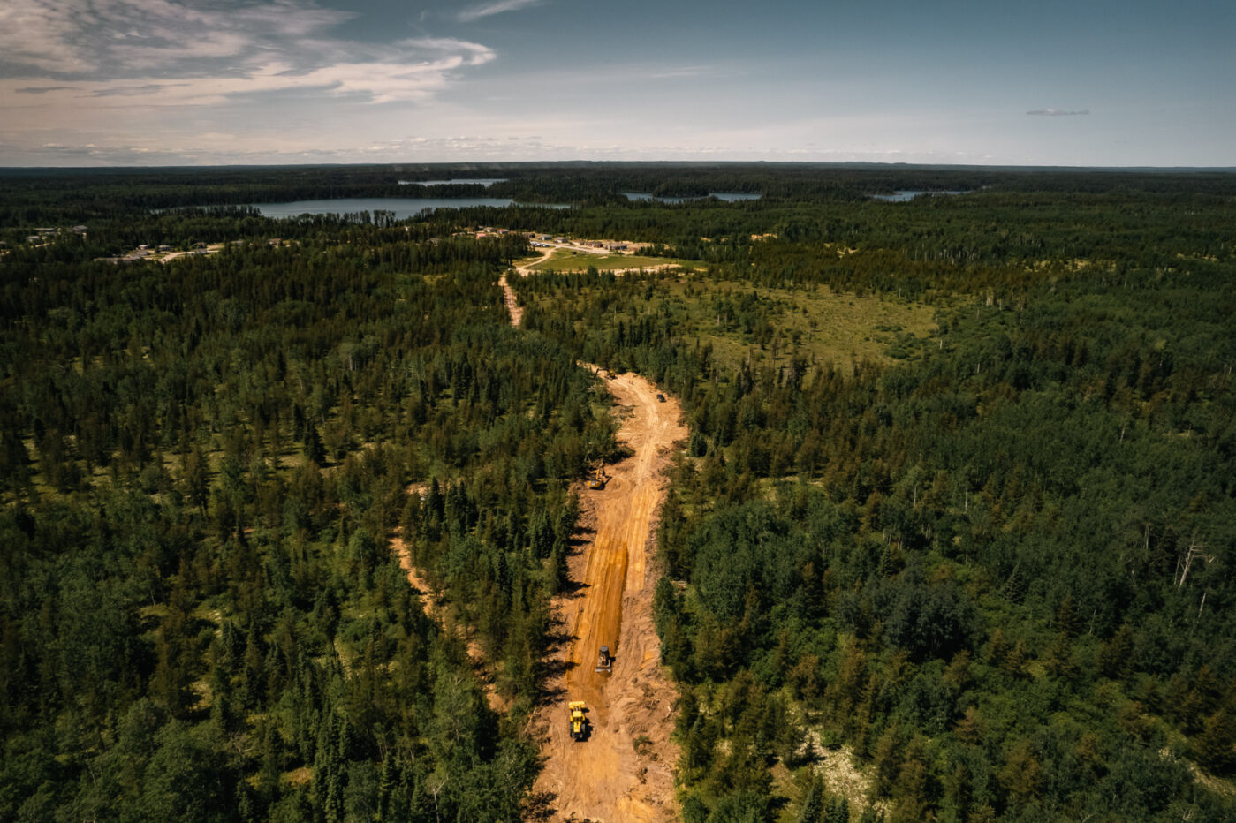
Training Priorities
Mining
Health care
Trades
Forestry/Biomass
Clean Drinking Water and Wastewater management
Pre-apprenticeship trades
Science, Technology, Engineering and Mathematics (STEM)
Energy Advisor Training

Slide 8
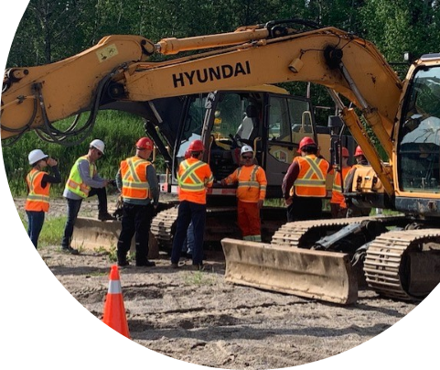
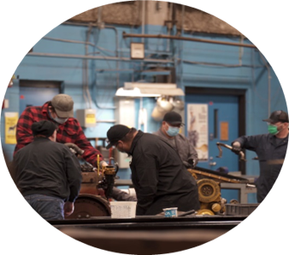
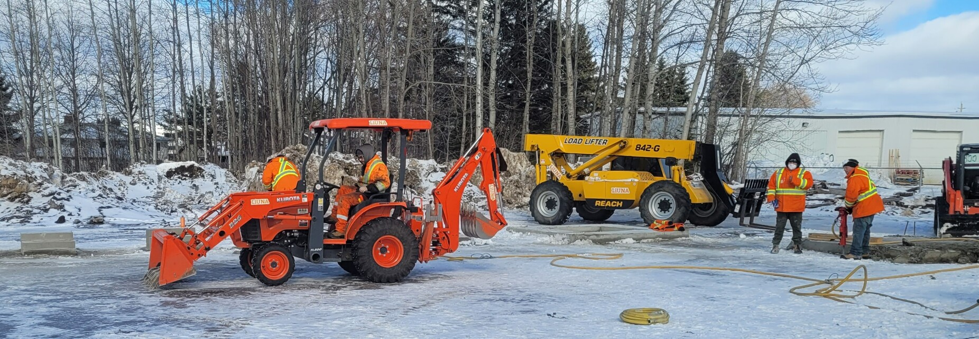
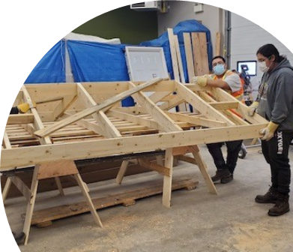
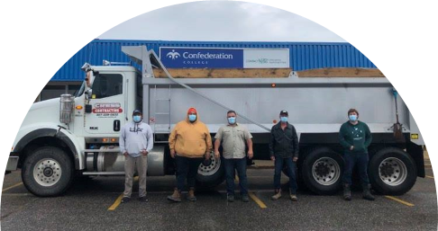
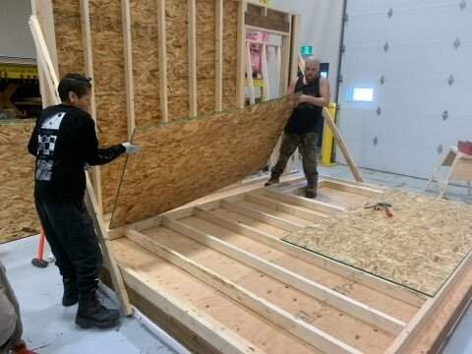
Trades in the Community
Notes:
Lake Nipigon FN (Animbiigoo Zaagi igan Anishnabek)
Expanded a road into the subdivision
Aroland FN
Added a road
Ginoogaming FN
Fixed a road
Sandpoint FN
Both programs fixed a road a changed culverts
Built new road for pow wow ground in LL58 as part of HEO course
Fixed existing pow wow grounds
Students were offered employment with GGM and within community.
Oshki Wenjack
We built an Ice Shack and Trappers Cabin as part of our Energy Savings and Preventative Maintenance course.
Proceeds of the sales go back to supporting post secondary training and programs for Oshki students.
Deer Lake FN/Oshki Wenjack - Supported housing initiatives through Level 1 Pre App carpentry in community
Mining Essentials - Pic Mobert FN. - Students received certificates from MiHR (Mining industry human resource council) , College and their Underground Diamond Driller- Basic Common Core.
Drilling was done in partnership with Boart Longyear and Barrick-Hemlo. Students were underground at the mine site. 6/8 Students were employed after and due to the course.

Slide 9
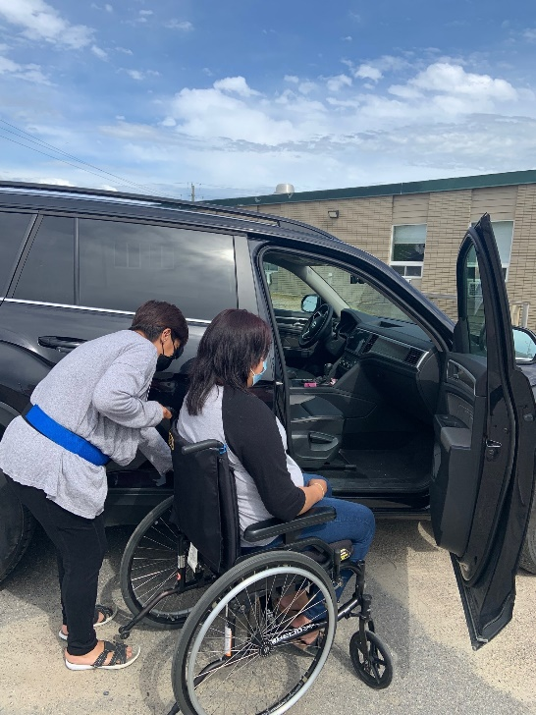
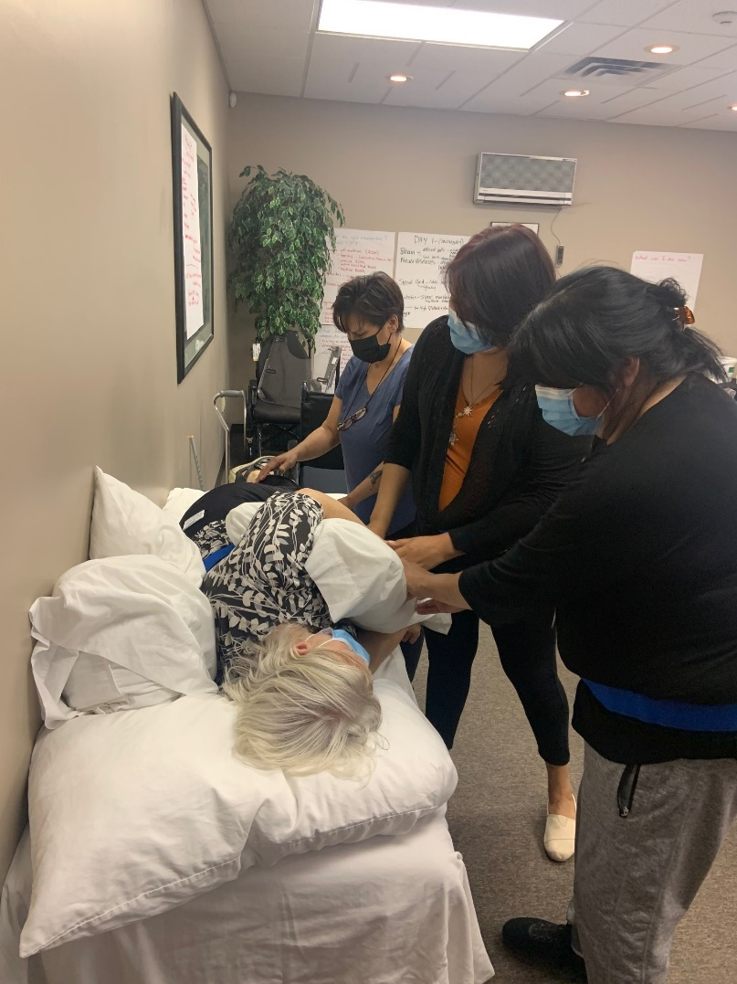
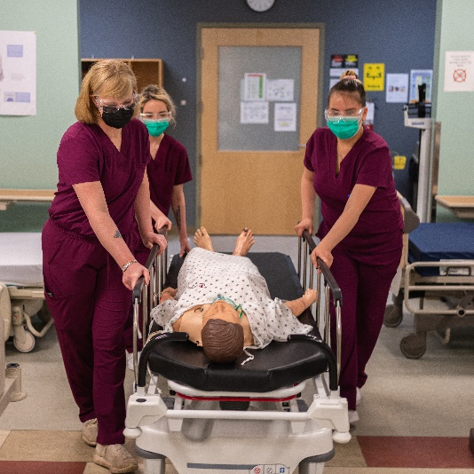
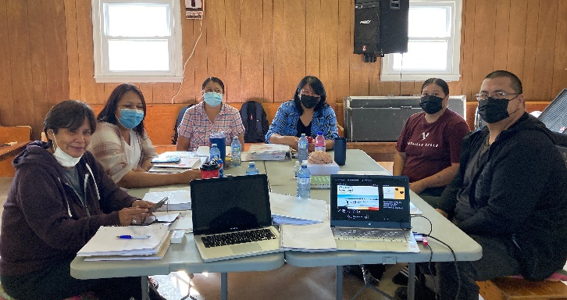
Health Care in The Community
Community Rehabilitation Worker Program
St. Joseph's Care Group
Eabametoong, North Caribou, Sandy Lake and Bearskin Lake.
Personal support worker program. Medical Lab Assistant Home and Community Support worker
Wiigwas, Sioux Lookout First Nations Health Authority, SLAAM, OSHKI-Wenjack, Dilico
Notes:
The community rehab worker is in response to the need for people in community to follow up after individuals go for surgery return home and need therapy
PSW/MLA and Home and community support worker Skills Advance Ontario
Grassy Narrows First Nation Mercury care homes to be a part of the care planning team – delivered in community PSW training.

Slide 10
Critical Success Factors
Responsive System
Listen to experts
Humble and creative
Advocate at federal and provincial funding tables
Notes:
We believe in investing in relationships and partnerships in order to create the best and most responsive system to meet the need of community and industry
The experts are the community members and industry on hat they need and how it should be done, the college is the expert on education and qualifications
We are often invited to sit at the table with the government and community to advocate for the funding, support and training needed to ensure that the community can be successful

Slide 11
Questions ?
THANK YOU

