Slide 1

DEMAND AND OPPORTUNITY
Energy Challenges in Northwestern Ontario
Presentation by the
Northwest Energy Task Force

Slide 2
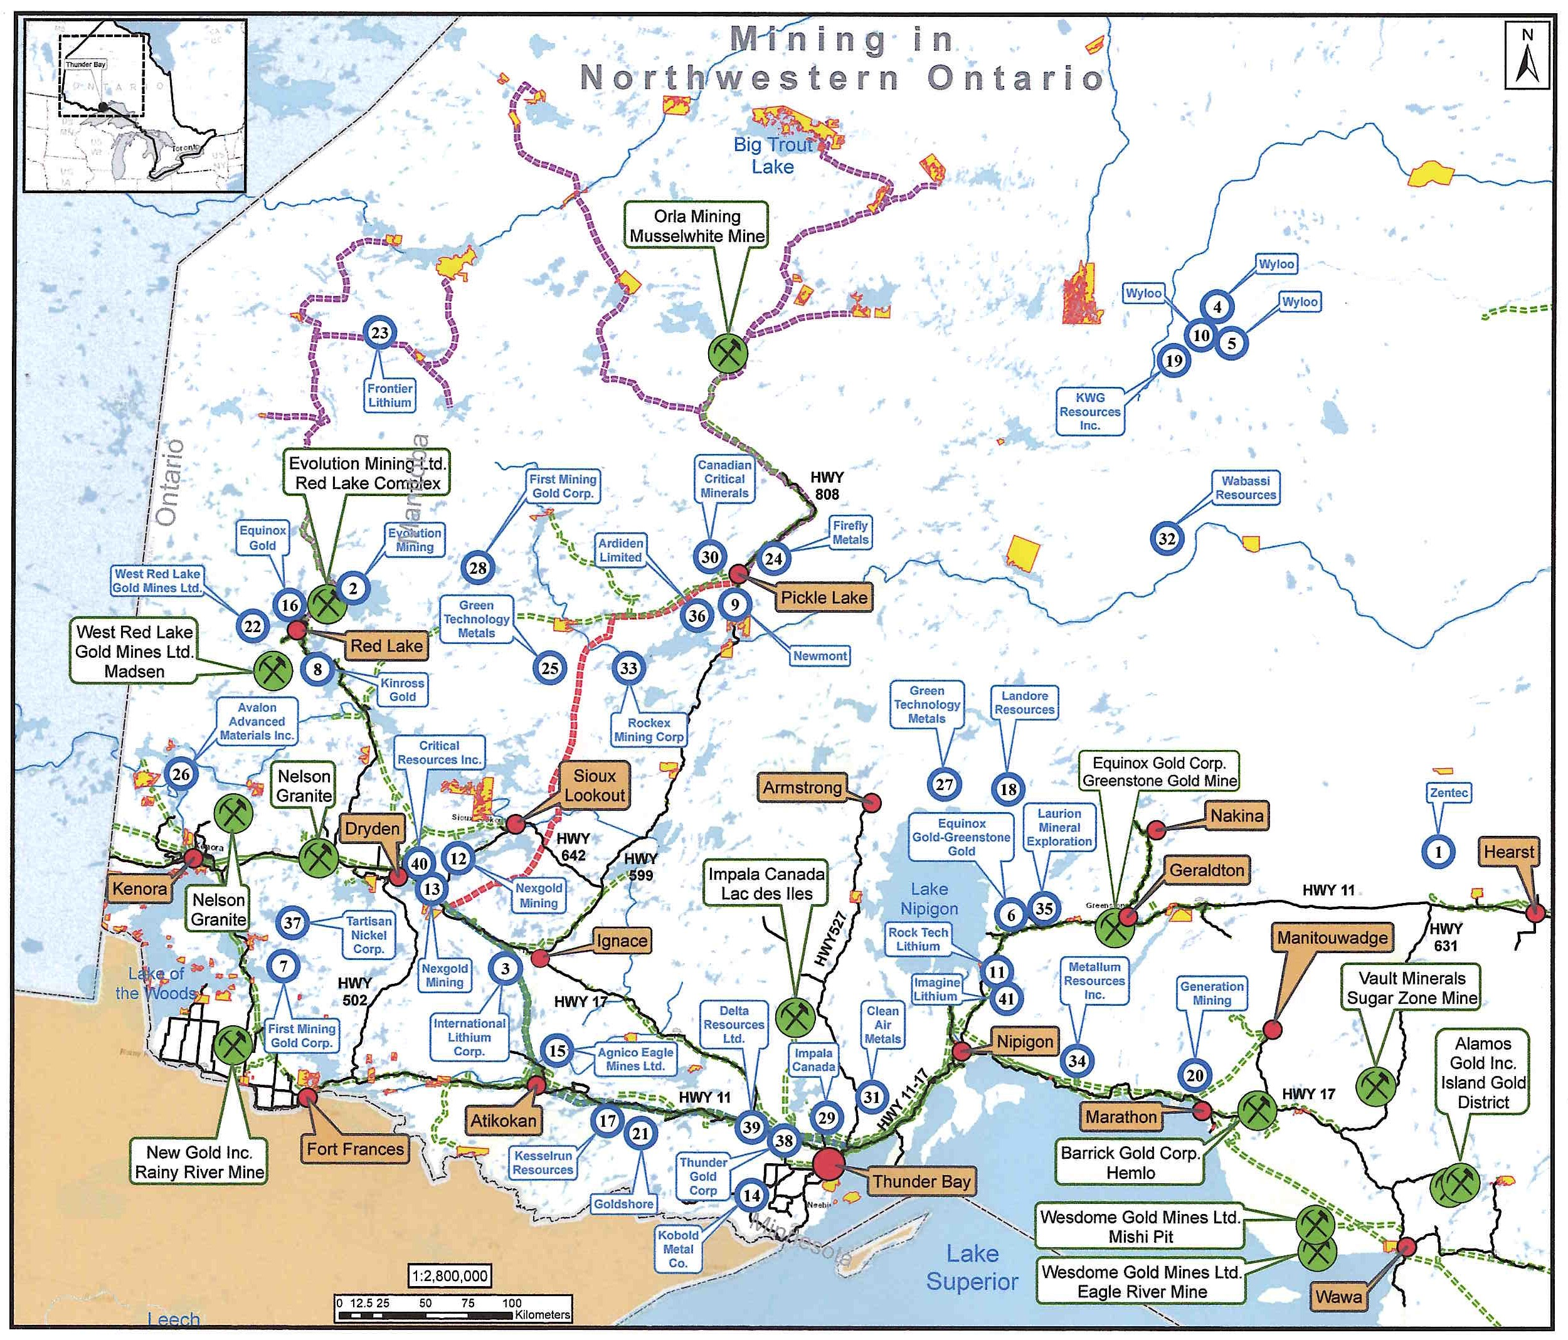
12 Producing Mines
41 Major Mining Projects

Slide 3
41 Major Mining Projects
37 Advanced Stage aim to operate by 2033

Slide 4
13 - Critical Minerals
C
L
6 are copper-nickel palladium/platinum
4 are lithium
1 each of chromite, graphite and zinc
P
Cop
P
L
L
L
Cop
L
L
P
P
C

Slide 5
16 estimate construction costs of
$7.6 billion
by 2035

Slide 6
8 projects
= 3,820 construction crew
7 projects
= 2,360 operating staff

Slide 7
Transmission Shortfall

Slide 8
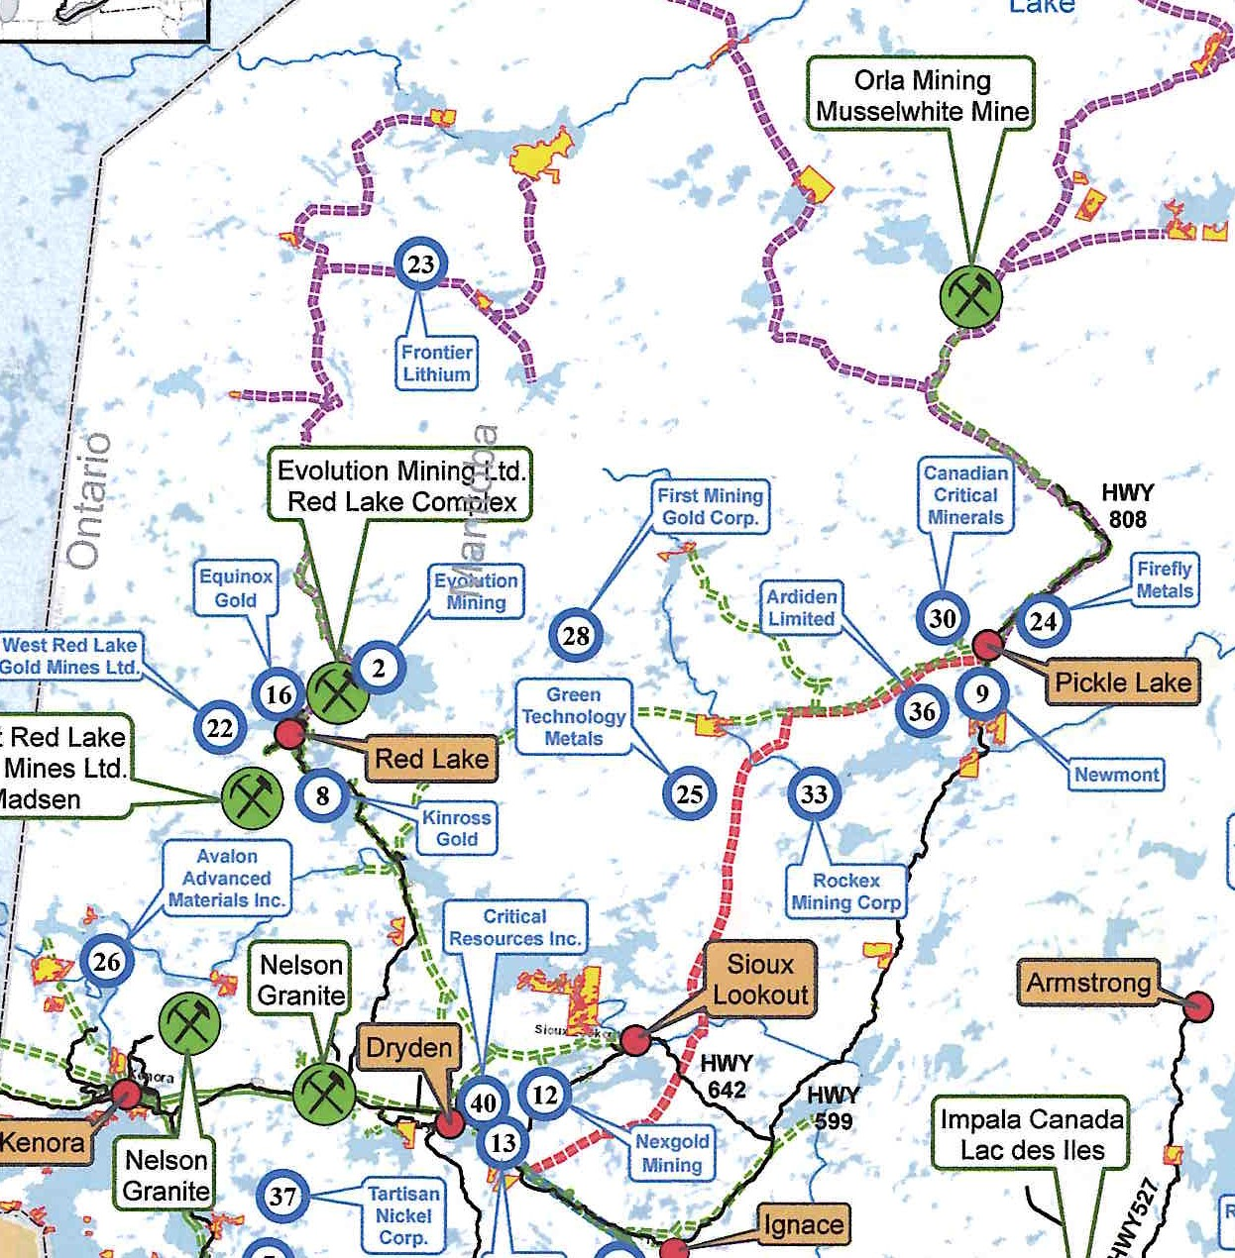
Area Served by Wassigan Bulk Transmission Line
15 NEW MINES
550 MW by 2033

Slide 9
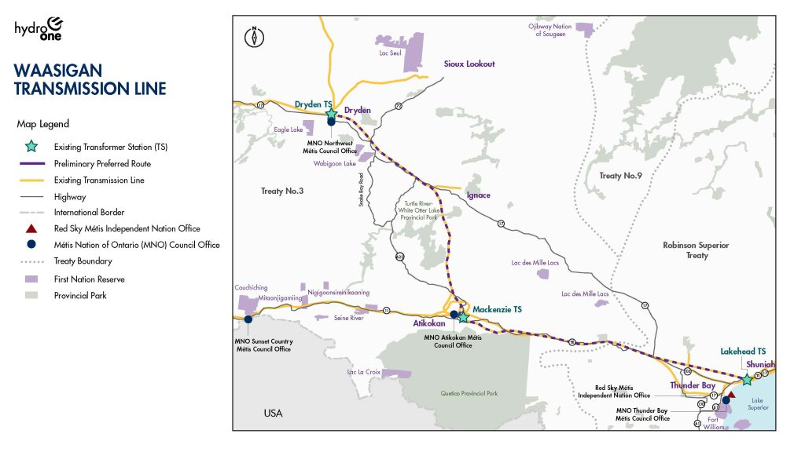
550 MW New
One circuit 175 MW Capacity
Two circuit 350 MW Capacity

Slide 10
550 MW New
One circuit 175 MW Capacity
NW ETF Recommend 2nd 175 MW Circuit
Two circuit 350 MW Capacity
Recommended Changes

Slide 11
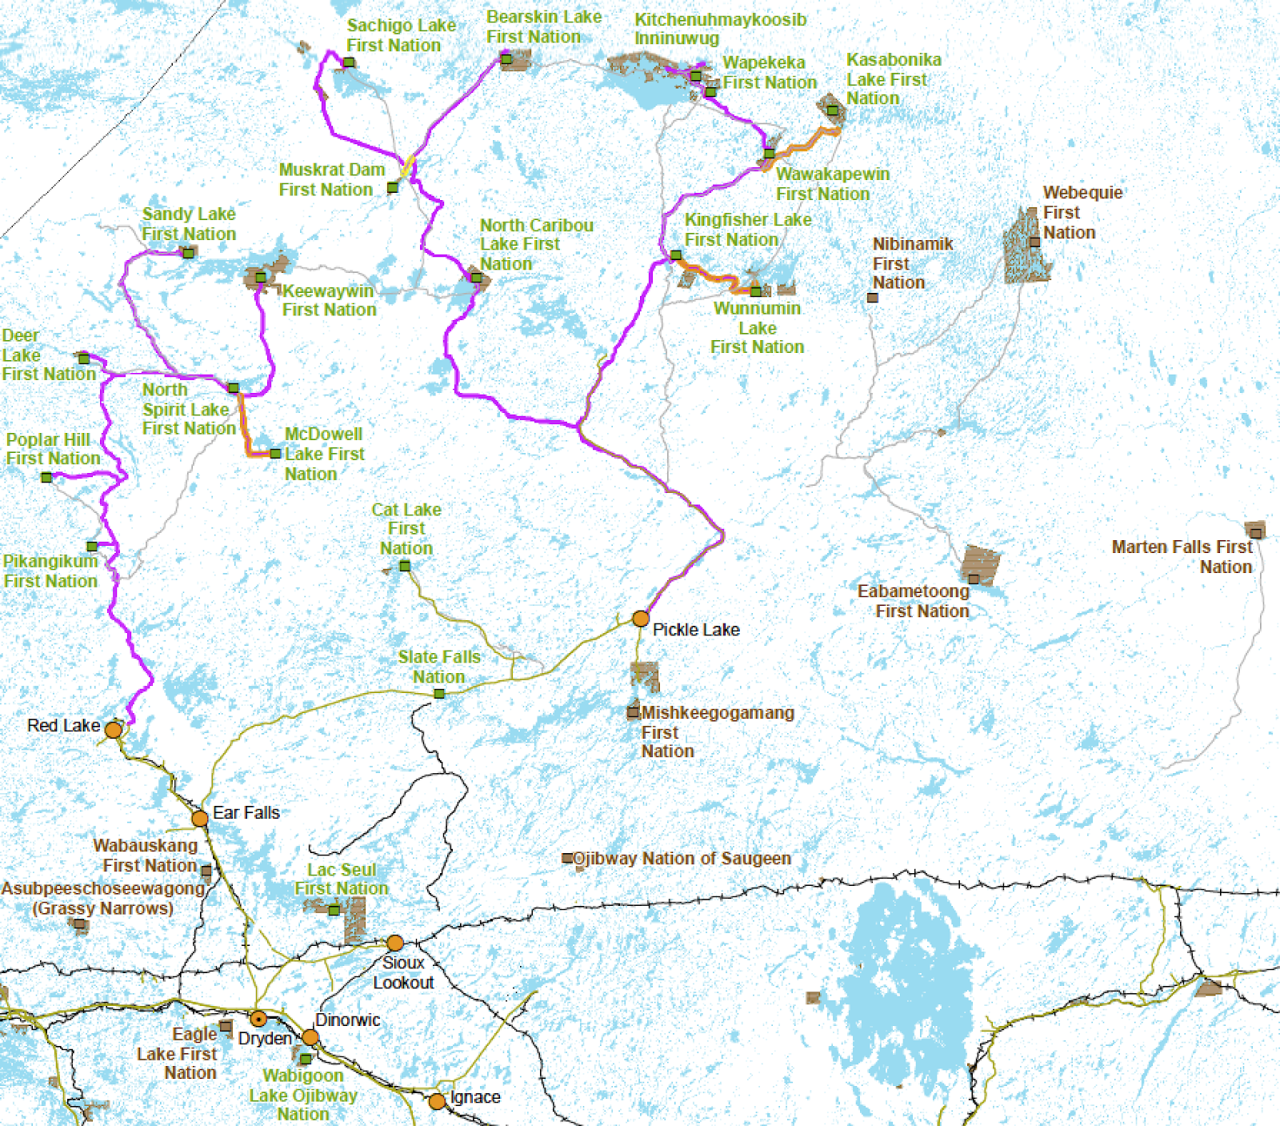
Existing Transmission Lines from Dryden North
Connection to Red Lake at or near capacity.
Wataynikaneyap Power

Slide 12
Recommended Changes
NW ETF
Add a 2nd circuit to Pickle Lake to Watay Power
Wataynikaneyap Power

Slide 13
Recommended Changes
Hydro One Proposes twin circuit
Dryden to Red Lake & Serving Pickle Lake
HONI
Wataynikaneyap Power

Slide 14
Recommended Changes
NW ETF
Additional Line North of Red Lake
HONI
Wataynikaneyap Power

Slide 15
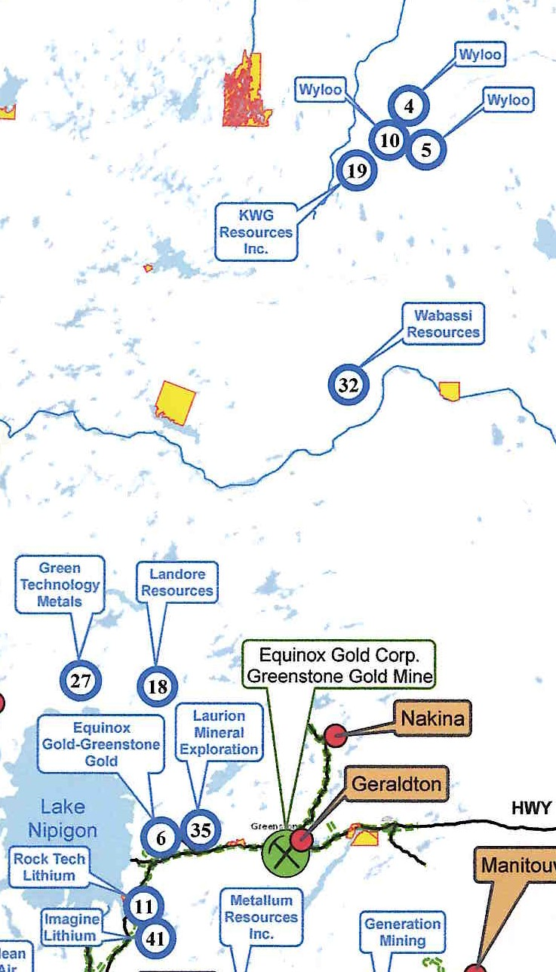
Ring of Fire
and
Nipigon North
11 Mines
Projected 220.5 MW

Slide 16
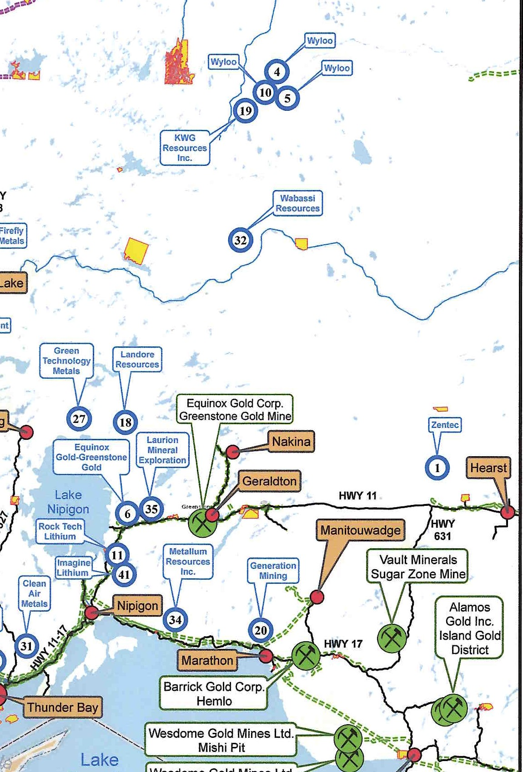
Transmission Issues
Greenstone served by a radial line with no redundancy and at or near capacity
Hydro One proposes 230 KV line to Geraldton – two options
Essential that Ring of Fire line connects through Geraldton
Required to connect Ring of Fire

Slide 17
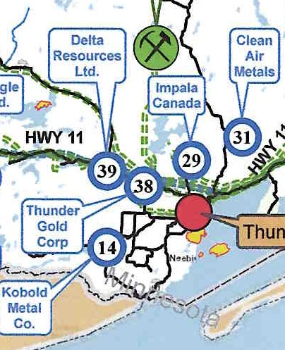
Immediate Thunder Bay Area
5 mines and potentially 4 processing facilities
365 MW New Load

Slide 18
CEDC led planning group
Synergy North
IESO
Hydro One
to determine solution

Slide 19
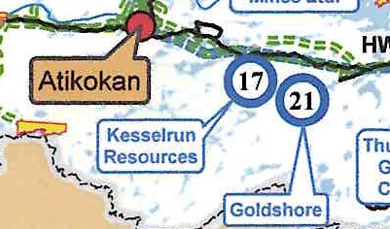
West of Thunder Bay
2 mines (60 to 70 MW) + Disruptive Services

Slide 20
Power Availability
Base load today is 484 MW.
Base load + mines require 1,968 MW.
NW generates 430 MW
Existing capacity for growth 600 MW
.

Slide 21
Power Availability
Potential Shortfall by 2033 228 MW
Does not include
Drought reduces output by 230 MW
Conversion from gas to electric heat
Housing & Business growth
Electric Vehicle growth

Slide 22
VARIABLES
Not all mines listed may be built
Some mines may open later than planned
Other mines not listed may be developed

Slide 23
New Supply

Slide 24
Existing Biomass Generators
Atikokan Generating Station &
Thunder Bay Pulp and Paper
Expand output capacity
Enter into minimum 10 year contracts

Slide 25
New Biomass Generators
Forest industry only cutting 46% of annual allowable cut
30 to 40% of what is cut is available for biomass generation
Ideal add on for existing sawmills
Potential redevelopment for closed sawmills
New, stand alone opportunities

Slide 26
New Biomass Generators
Challenge to using biomass
more expensive on a per Kw Hour than other generators
Makes it hard to compete with other generators
Government needs to recognize the other benefits
  Use of a valuable forest fibre
  Jobs
  Taxes at all 3 orders of government
  Viability of communities

Slide 27
New Biomass Generators
Recommended that
Recommend that the IESO establish a program that reserves a block of MWs dedicated to forest biomass projects.
Recommend that the IESO Establish bioheat & district energy procurement mandates for public building infrastructure.

Slide 28
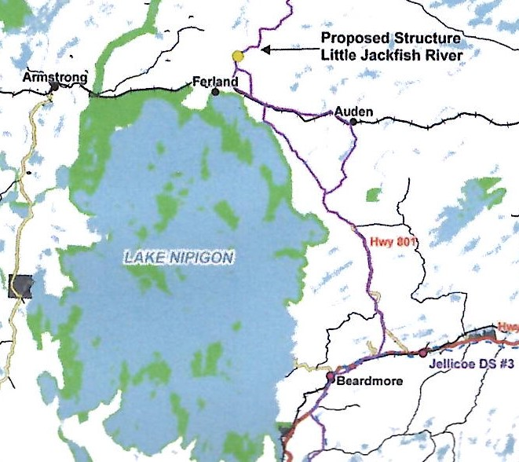
Hydroelectric Generation
Little Jackfish
80 MW

Slide 29
Potential Hydro Generation Along
Wataynikaneyap Power Lines
North of Red Lake – 67.6 MW
North of Pickle Lake – 207.5 MW
MNR Policy – Artic Watershed up to First Nations
Energy Task Force recommended to IESO that proposals for generation should be exempt from bidding process

Slide 30
Solar and Wind
Northwest no longer an ORANGE Zone
IESO should seek bids from Solar and Wind proponents with priority for NW projects.

Slide 31
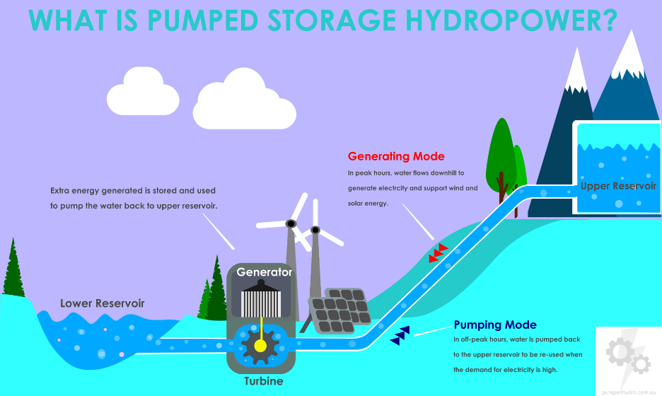
Storage
Pumped storage
Compressed air storage
Electric Battery storage

Slide 32
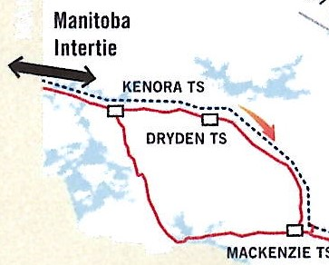
Ontario-Manitoba Interconnection
An import of an additional 200 MW from Manitoba could be accommodated when regional load grows sufficiently to absorb the power directly in the northwest. (IESO-OPA 2014)
The Government, through the IESO should examine the opportunity to permanently expand the 250 MW intertie capacity and contract with Manitoba Hydro

Slide 33
Our Advocacy
Tentative Meeting with Hydro One
Continue to interact with the IESO
Seek meeting with next Minister of Energy for Ontario
Ongoing informing of energy issues with municipalities and industry

Slide 34
Questions from the Media
Media connecting virtually asked to identify yourself and the media outlet you represent

Slide 35
Questions from Municipalities
Please identify which Municipality you are from

