Slide 1
Practical Solutions to Road Safety
NOMA Conference
Thunder Bay
April 2024

Slide 2
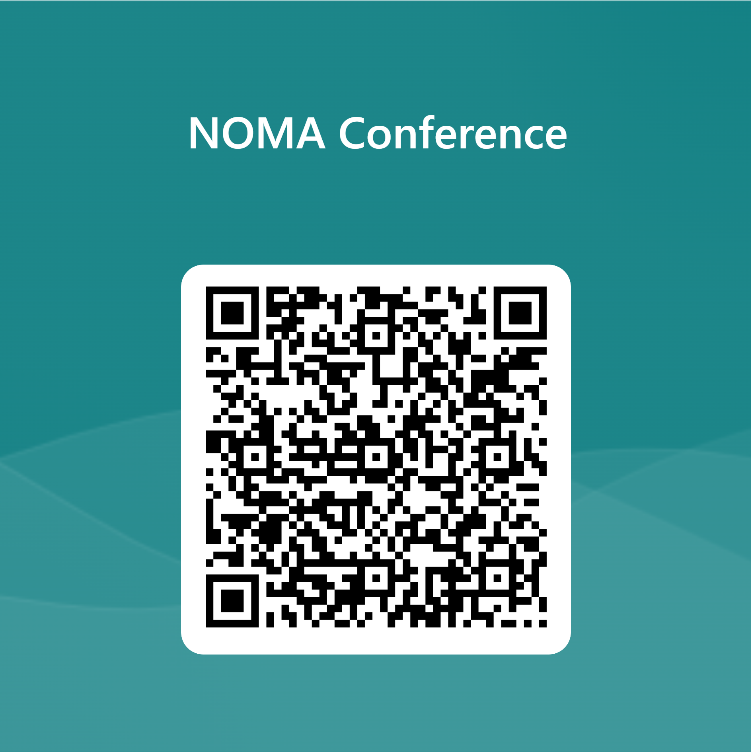
Poll Question #1
Related to roads, what is your most common complaint?

Slide 3
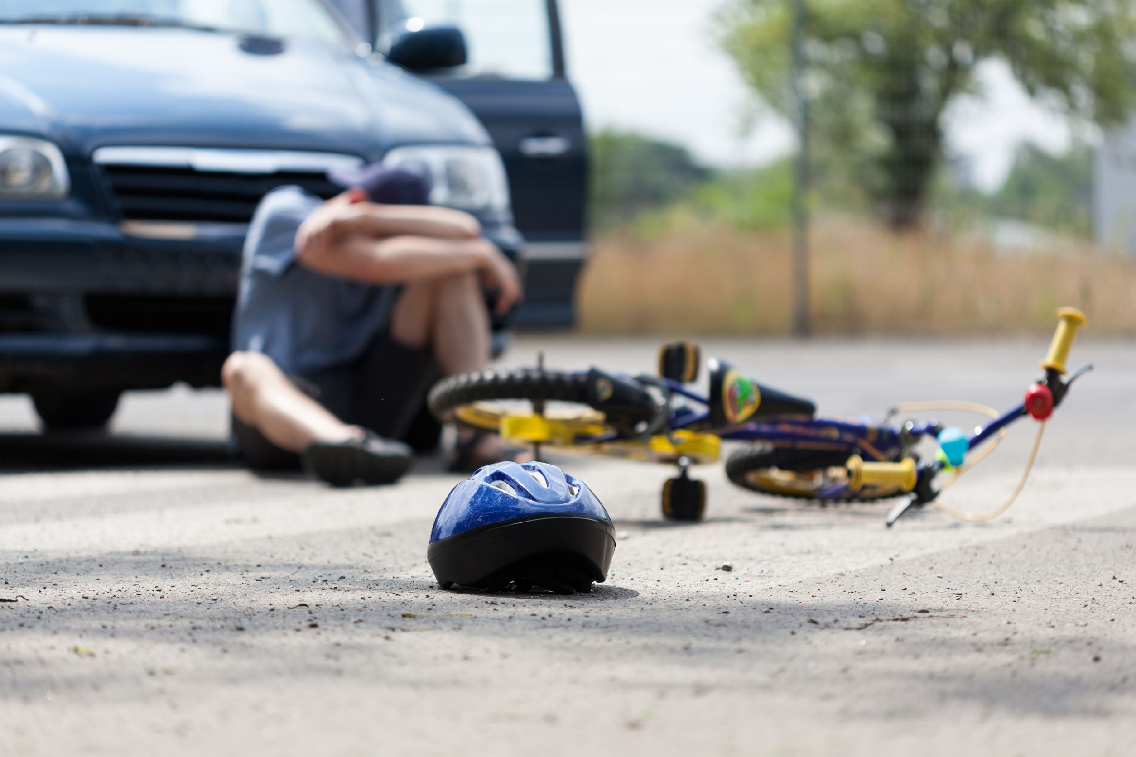
“Pedestrians have less than a 50% chance of surviving an impact at speeds above 45 km/h, but a 90% chance of survival at speeds below 30 km/h.”
“Risk of fatal collisions rises 4-5% for every 1km/h increase in speed”
Source: The City of Toronto Automated Speed Enforcement Program Evaluation, Final Report 2023,
Prepared by The Hospital for Sick Children Research Institute
Picture: https://attorneys.us/school-zone-accidents/
Notes:
Hospital for Sick Children Research Institute released report - completed March 2023 to evaluate effectiveness of City of TO ASE program
Let stats sink in for a moment.
Speed kills.
Completely controllable behaviour – incumbent on society to consider others and slow down.
Options exist for municipalities to help slow them down.

Slide 4
Road Safety starts with you…
The Municipal Impact
Notes:
Municipalities have a key role they can play in traffic safety in your communities
They are responsible for planning and maintaining road networks, ensuring traffic flow, and communities operate as safe as possible.
Discussing practical things you can do in your communities to increase safety for both drivers and other right of way users.

Slide 5
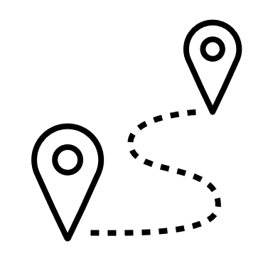
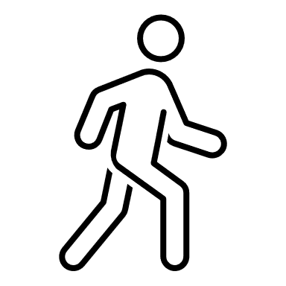
Traffic Calming
Reduce Speeds
Change the driving environment to impact behaviour
Reduce Cut-through Traffic
Improve area for vulnerable users
Notes:
Wikipedia:
Traffic calming uses physical design and other measures to improve safety for motorists, car drivers, pedestrians and cyclists.
Basically, traffic calming involves changing the driving environment to impact behaviour.

Slide 6
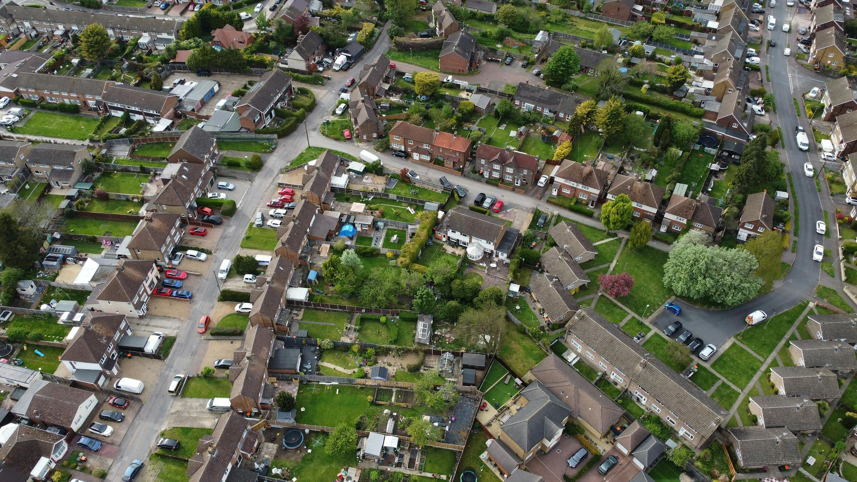
Design & Engineering
Planning
Traffic Flow considerations
Road classifications vs amenities
Reasonable speed limits
Usage
Notes:
Design & Engineering
Planning road networks
- straight aways vs calmer curves
- consider what amenities/access to amenities are along different classification of roads
- understandable/clear and reasonable speed limits based on area (ie. slower speeds in subdivisions, higher speed roads outside of subdivisions to encourage vehicle movement)
- consider who might use roadway (vehicles, pedestrians, bicycles, etc.)

Slide 7
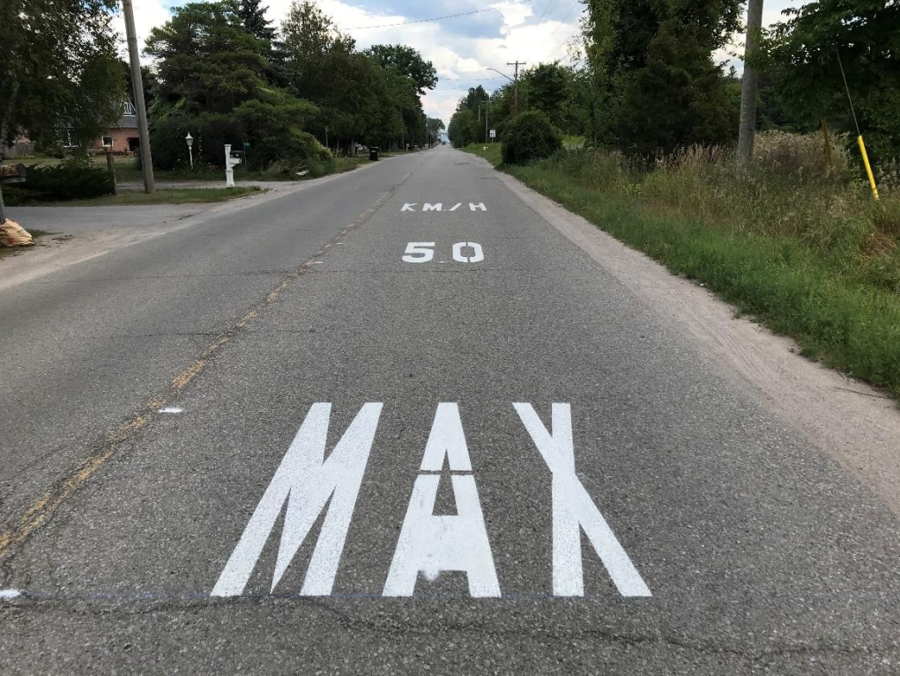
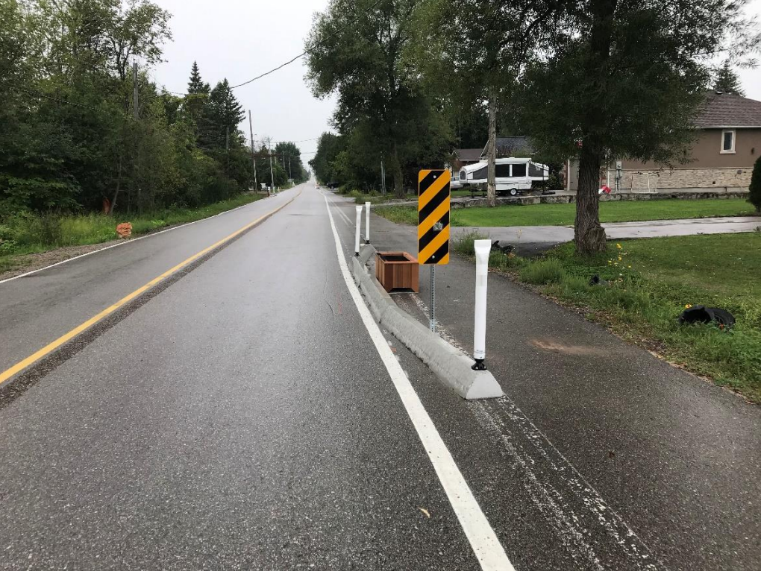
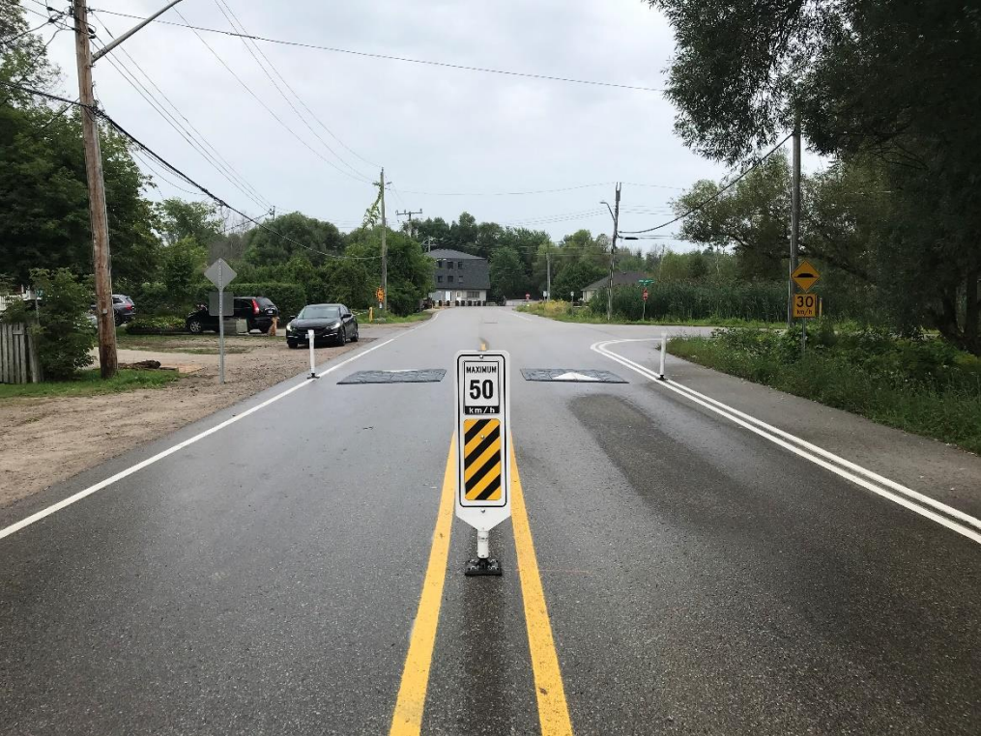
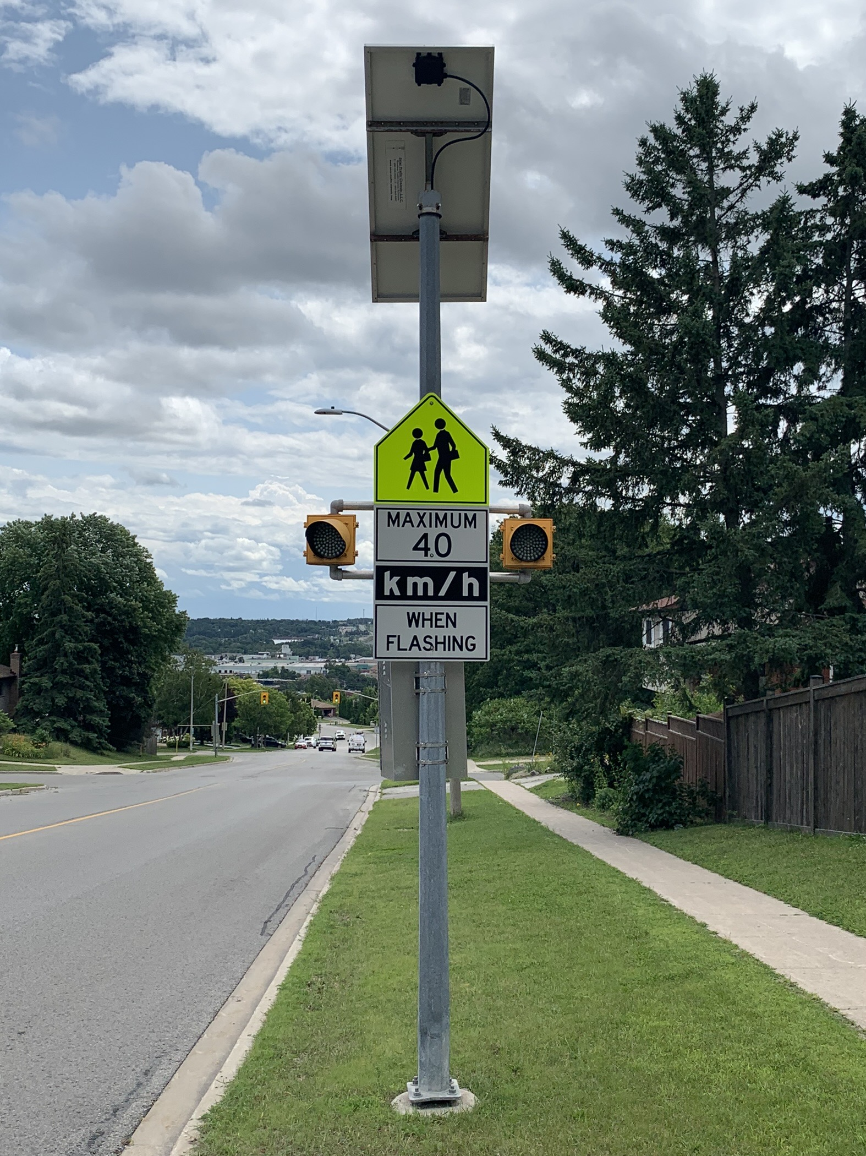
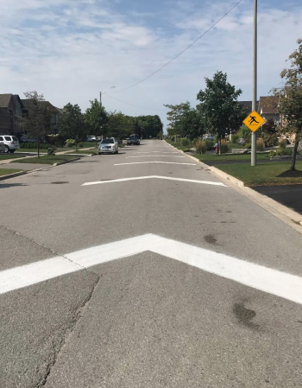
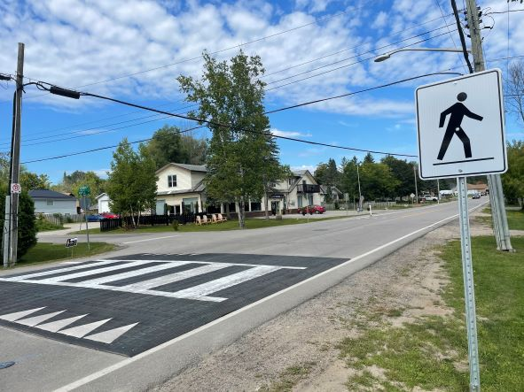
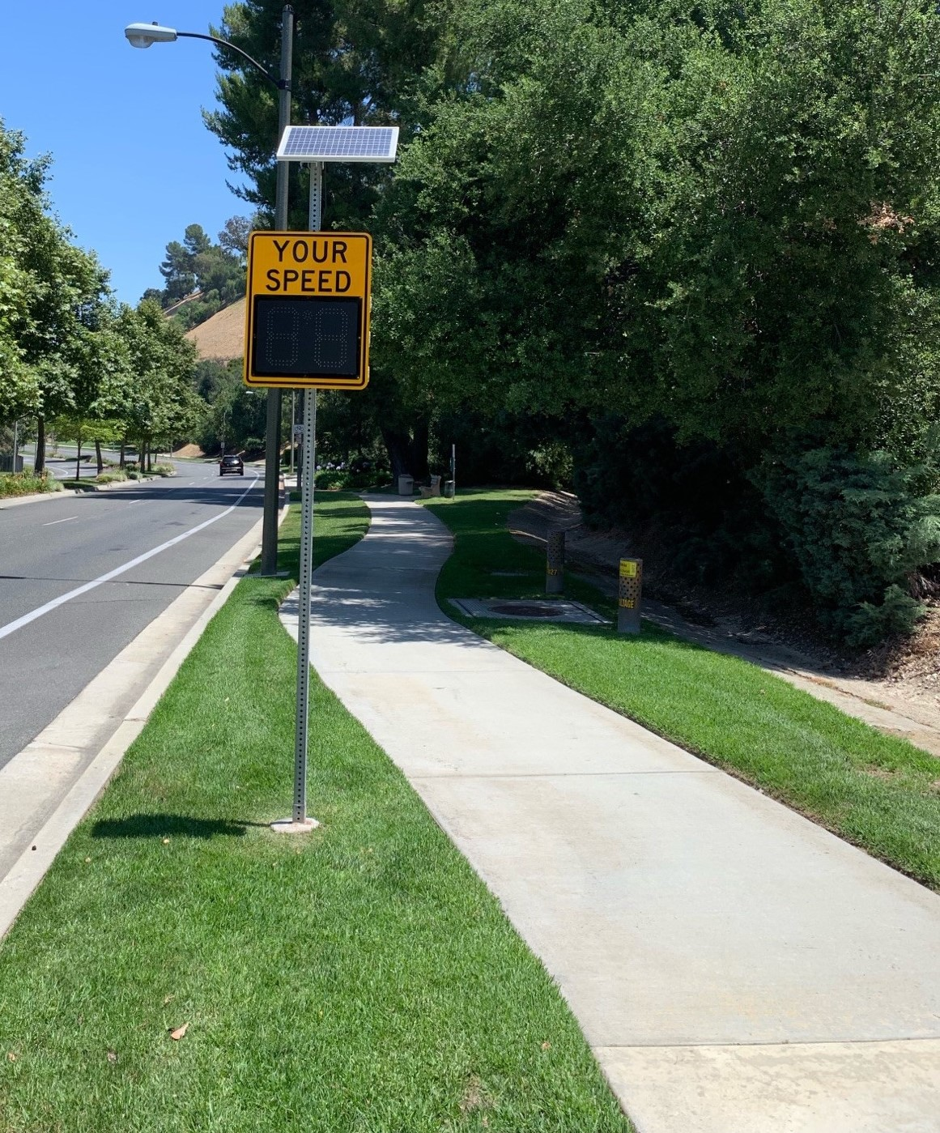
Notes:
Proven low-cost methods to slow traffic can include physical measures such as speed humps, chicanes, lane narrowing, or curb radius reductions.
Keep in mind road operations and emergency vehicles.
Methods can also include non-physical measures such as radar feedback signs or pavement markings.
Innisfil:
"MAX 50 KM/H" pavement markings – decreased speed on weekends (~5 kph) but not weekdays
Chicanes - decrease in speeds both weekends and weekdays (2-3 kph)
Speed cushions
Wide double centreline
Centreline delineators
Edgeline delineators
Raised crosswalk
Decrease in speed both weekdays and weekends (~4-5 kph)

Slide 8
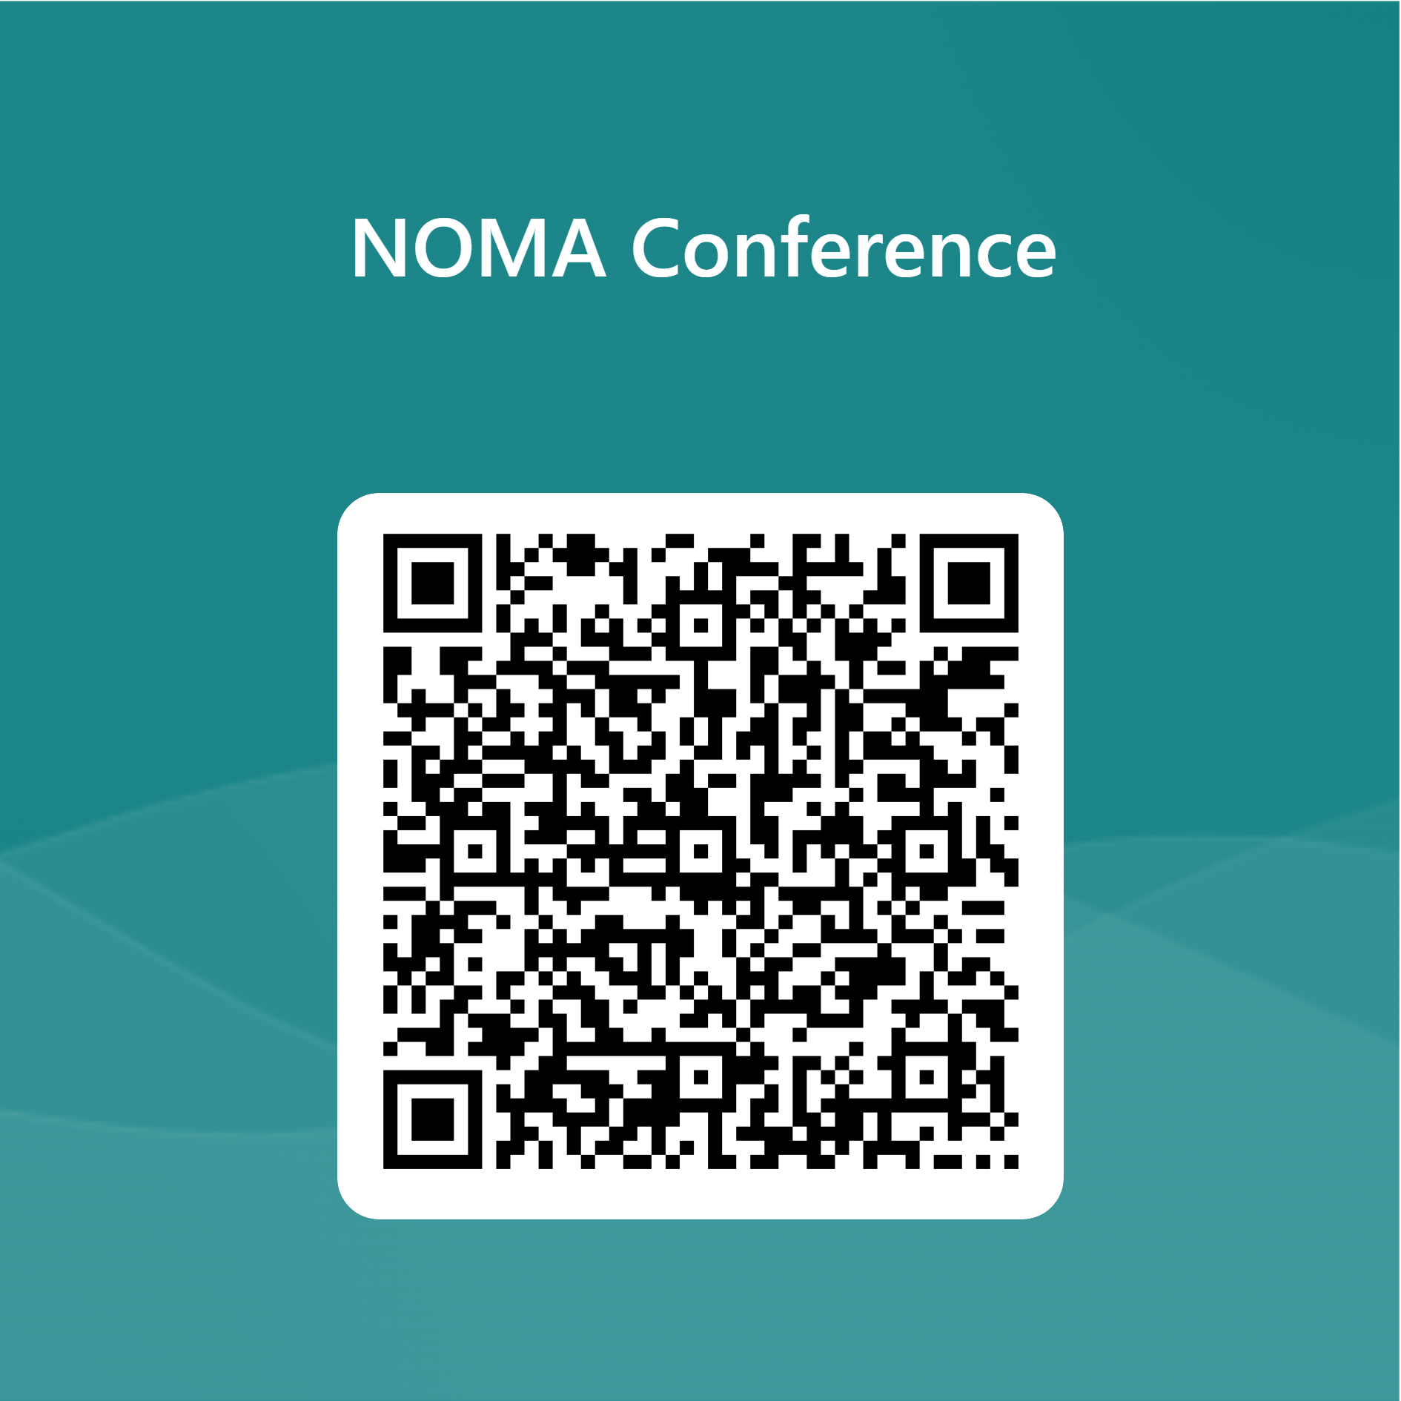
Poll Question #2
What is missing in all of these efforts?

Slide 9
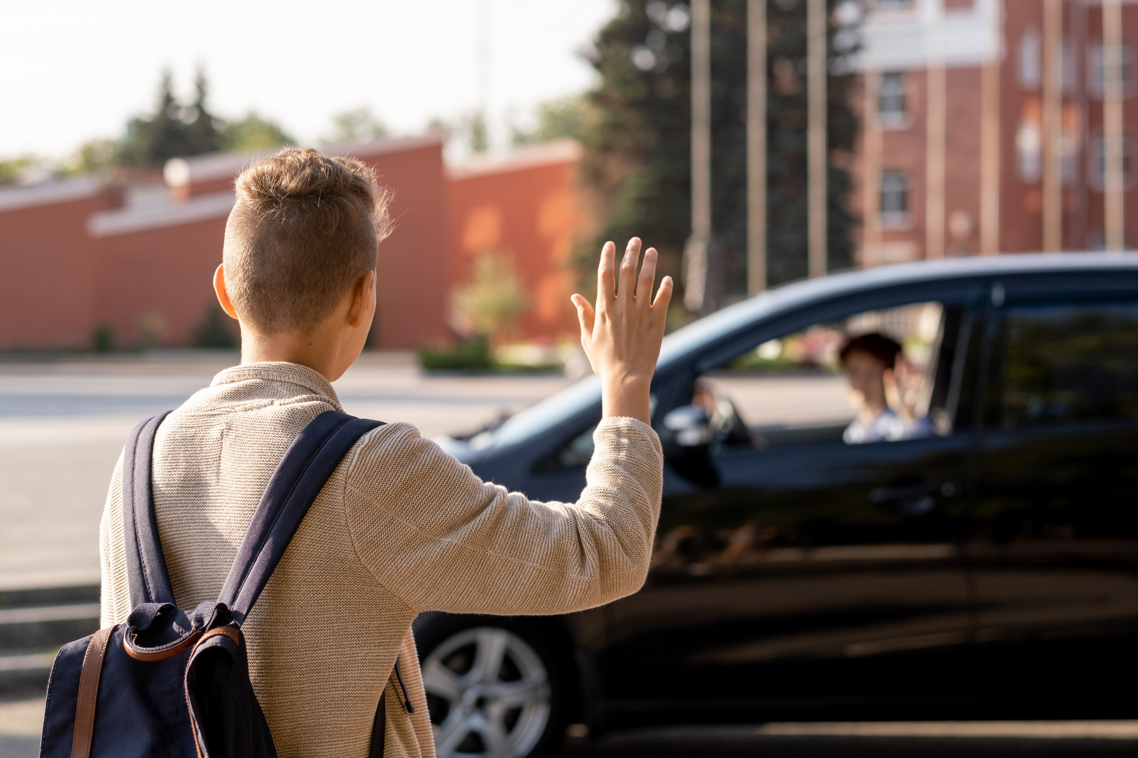
Behaviour Change Comes From
Community Norms
Enforcement
Personal Responsibility
Safety Awareness

Slide 10
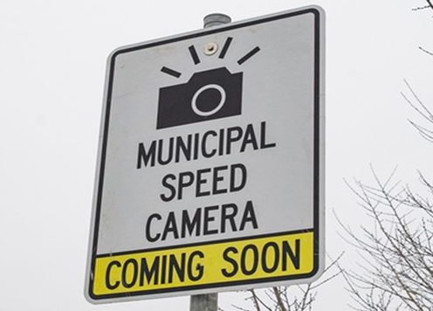
Automated Speed Enforcement
Automated system to detect and capture images of vehicles travelling above the speed limit
Enforce speed limits in School & Community Safety zones
Improves Safety!
Up to 45% reduction in number of speeding vehicles
5%-69% collisions
12%-65% injuries
17%-71% fatalities
Notes:
Compliments other safety measures (policing, engineering design, education)
Sick Kids Report findings:
ASE led to reductions:
5-69% collisions
12-65% injuries
17-71% fatalities
45% reduction in number of vehicles speeding
Decrease of 7.5kph (85th percentile) speed
“This automated speed enforcement program was effective in significantly reducing the number of vehicles speeding, and the overall vehicle speeds, in community safety zones near Toronto schools.”
Risk of fatal collisions rises by 4-5% for every 1km/h increase in speed

Slide 11
Let’s continue the conversation…
Judy Dezell
Director, Enterprise Centre, Business Partnerships & LAS
jdezell@amo.on.ca

