Slide 1
Celebrating the North! Municipal Success Stories in Northwestern Ontario
NOMA Conference
Thunder Bay, ON
April 2024

Slide 2
Who is LAS?
AMO’s Business Services
30+ years delivering programs and services for municipalities
Not-for-profit, governed by a Board of Directors
90% of the municipalities in Ontario depend on LAS
Helping Communities Work Better

Slide 3
LAS Solutions
Administrative
Automated Speed Enforcement
Closed Meeting Investigator
Sewer & Waterline Warranty
Energy
Electricity
Energy Planning Tool
Facility Lighting
Natural Gas
Financial
Group Benefits
Home & Auto Insurance
Investments (ONE)
Municipal Risk Management
Cyber Incident Management
Municipal Assets
Road & Sidewalk Assessment
Group Buying (Canoe)
Education and Training
Energy Training Workshops
Digital Toolkit (AMO)
Barrier Free Website Builder
Electronic Signatures
Electronic Meeting Management and Livestreaming
Electronic Permitting
Freedom of Information (FOI) Solution
Occupational H&S Management
Risk & Claims Management System

Slide 4
Let’s Celebrate!

Slide 5
Here to serve NOMA members

Slide 6
NOMA’s Top Leaders

Slide 7
Electricity – The POWERful Commodity

Slide 8
Natural Gas – Just Warming up
13 NOMA Members
2023 Savings = 22% (over utility gas rates)

Slide 9
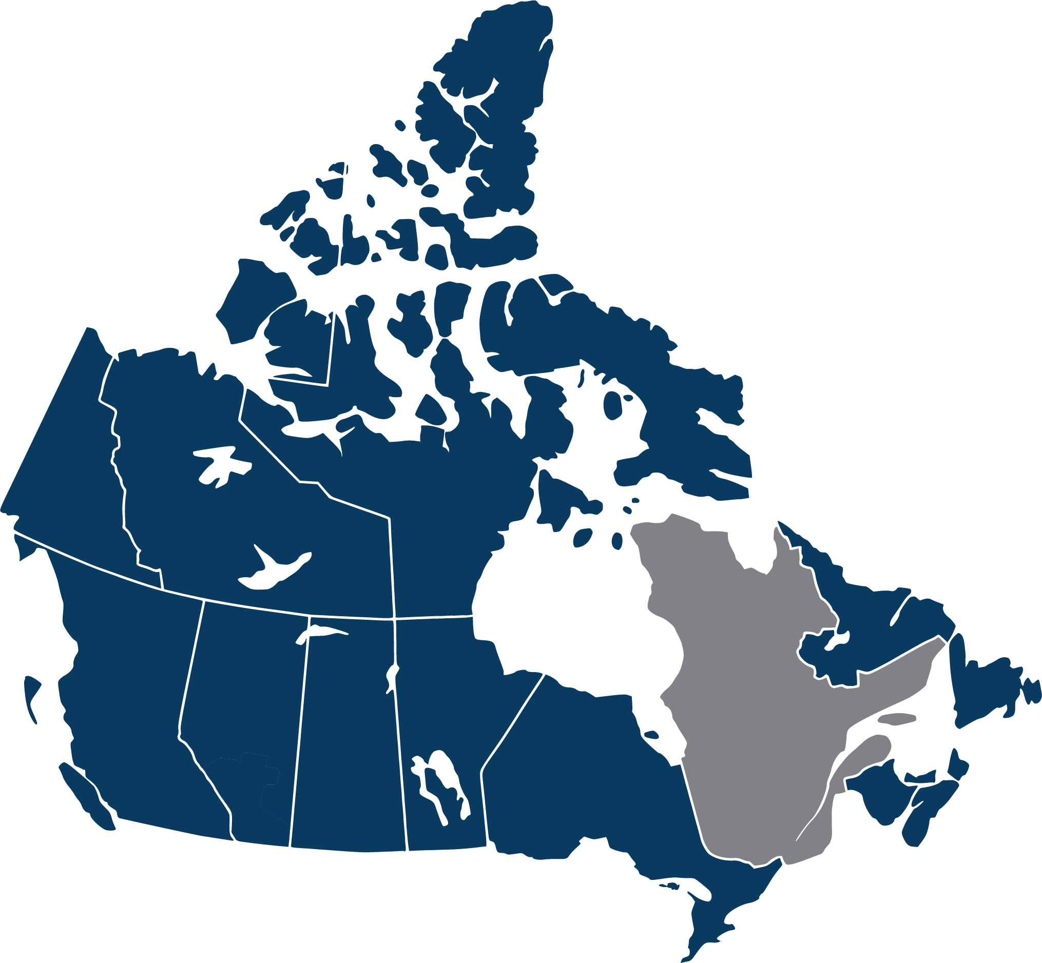
Municipal Group Buying
Canoe Procurement Group
cooperative purchasing that leverages economy of scale for the benefit of multiple buyers
Cross-Canada partnership with like-minded municipal associations
Bulk-buy rates for municipal, BPS, not-for-profits
Focused on products used by municipal sector
5000+ organizations strong
300+ Contracts, 70+ Categories

Slide 10
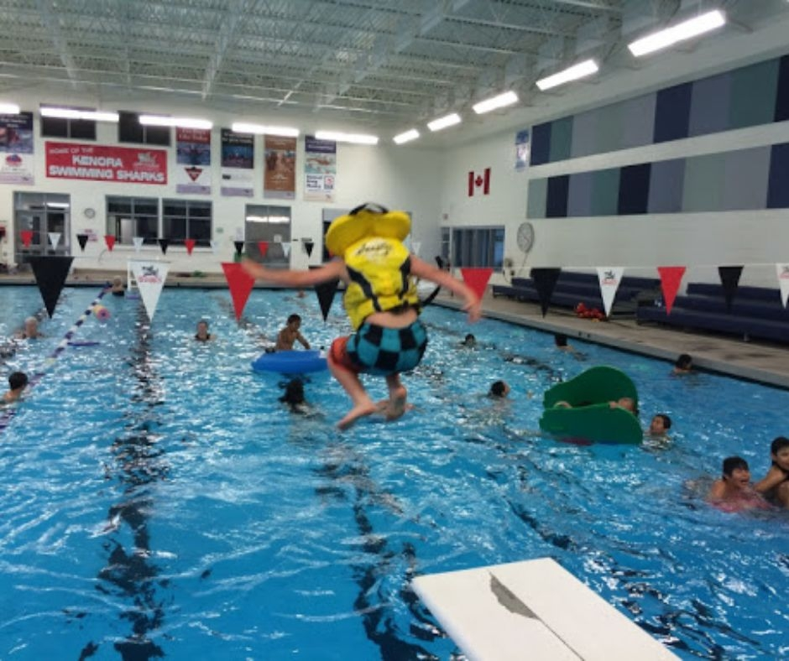
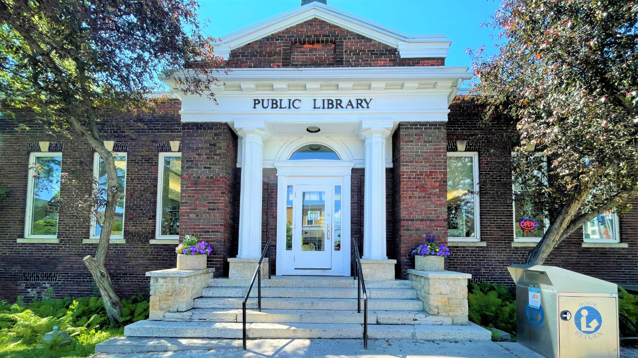
EnLIGHTening Stories of the North
Curling Rink & Arena
Saving $8,000/year
60% lower electricity
Source: www.ignace.ca
13 Projects
Saving $88,000/year
390,000 kWh electricity
(Power for ~40 homes!)
Source: Facebook
Source: www. kenora.ca

Slide 11
Building Better Roads
Road Assessment Service
6 Municipalities
14 scans
3-year scan rotation
1000+ km

Slide 12
ONE Investment – Saving for the future
22 NOMA members
$345 million invested
High Interest Savings Account
Legal List Investments (Government Bond, Corporate Bond, or Canadian Equity Funds)
Prudent Investment Option

Slide 13
ONE Investment – The Prudent Choice
Challenge:
Significant Capital Expenditures identified
Limited budget available
Limited staff capacity/expertise
Solution:
“Hire out” investment expertise
Multi-department committee established
PI = maintain control of short-term money and put long-term dollars to work for them

Slide 14
Coming Soon to a NOMA member…

Slide 15
Opportunity knocks!
Speed Enforcement
Risk Management
Customer Relations Management
(Digital Toolkit)
And more…

Slide 16
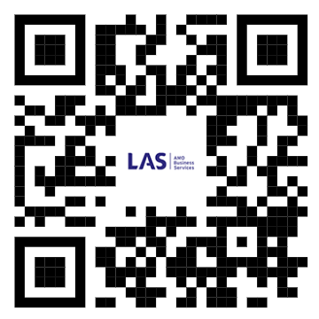
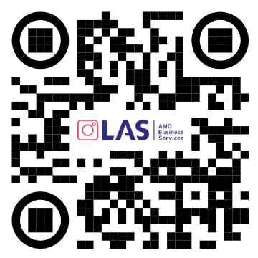
Let’s continue the celebration…
Judy Dezell
Director, Enterprise Centre, Business Partnerships, LAS & ONE
jdezell@amo.on.ca
Notes:
NOMA continues to inspire LAS and the province by demonstrating their leadership.

