Slide 1
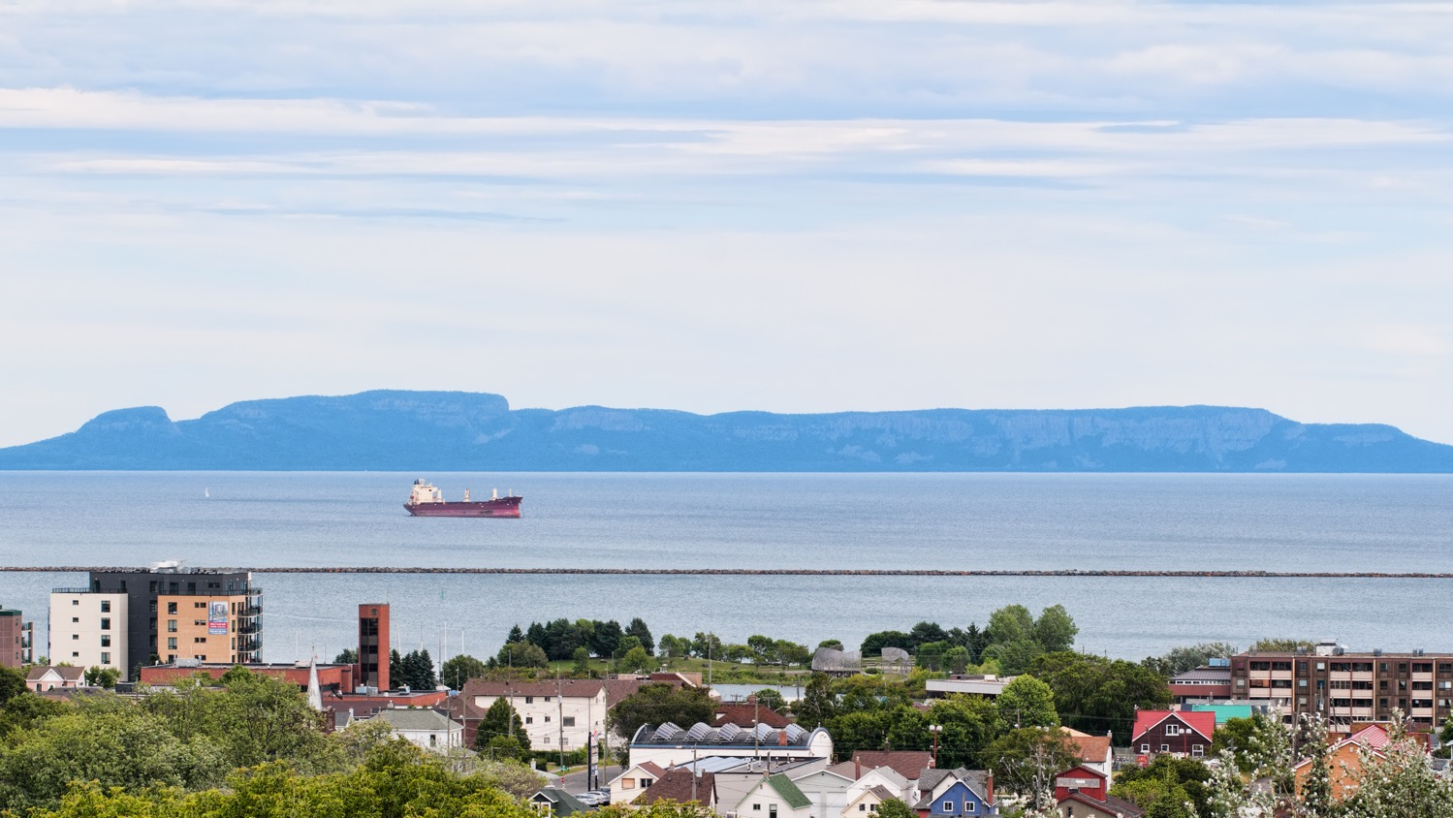
Sharing Property Insights and Meeting the Evolving Needs of Our Northern Partners.
MUNICIPAL PROPERTY ASSESSMENT CORPORATION
NOMA Conference Thunder Bay, Ontario April 24 - 26, 2024

Slide 2
Provincial system
Review.
We’re focused on affirming the importance of:
Regular Assessments
Information exchange for our municipal partners
Building enhanced services and products that meet the evolving needs of all those we serve

Slide 3
Improving the property assessment experience.

Slide 4
Our work in a non-reassessment year.
A 2023 snapshot
5.6 million
17,500
129,600
Inventory of properties maintained
Severances and consolidations processed
Calls from property owners, emails and chats
400,000
300,000
8,700
Sales transactions processed
Building permits processed
Requests for Reconsideration
160,000
87%+
8,800
Property inspections
Of new assessment added within one year of occupancy
Appeals closed
*All stats are as of October 27, 2023

Slide 5
Corporate Data Strategy.
Focusing on the Needs & Experiences of MPAC’s Audiences.
Adopting a Value-First Mindset.
Embracing an Enterprise-First Perspective.

Slide 6
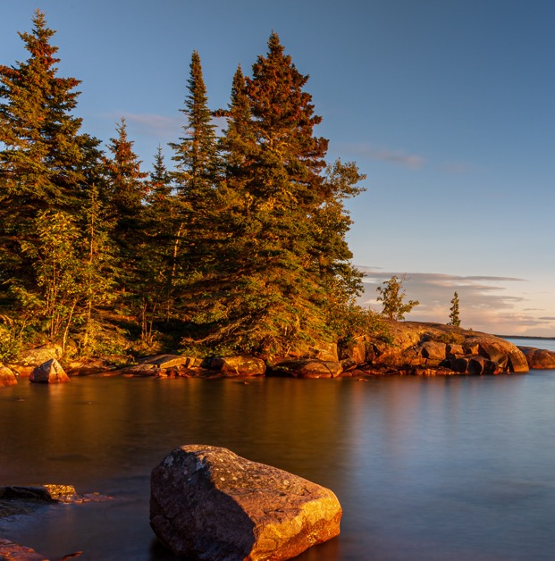
MPAC’s work in Northwestern
Ontario.
135
2,535
Municipal Engagements in 2023
Building permits completed in 2023
161
113
Municipal tax applications processed in 2023
Requests for Reconsideration processed for 2023 tax year
1,794
71
Sales reviews in 2023
Appeals closed on 52 properties in 2023

Slide 7
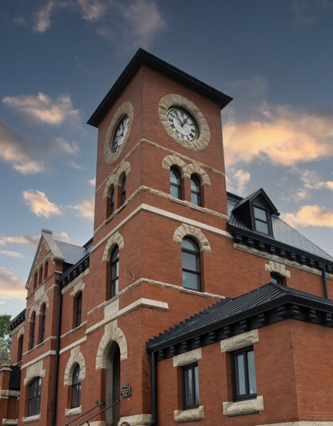
2,468 permits Received in 2023 in Northwestern Ontario
1
Thunder Bay
1,181
2
Kenora
143
1
Alterations/Renovations
487
Top 5 by municipality
Permit type
3
Dryden
104
2
New building
435
4
Oliver-Paipoonge
91
3
Garage
300
5
Fort Frances
68
4
Demolition
209

Slide 8
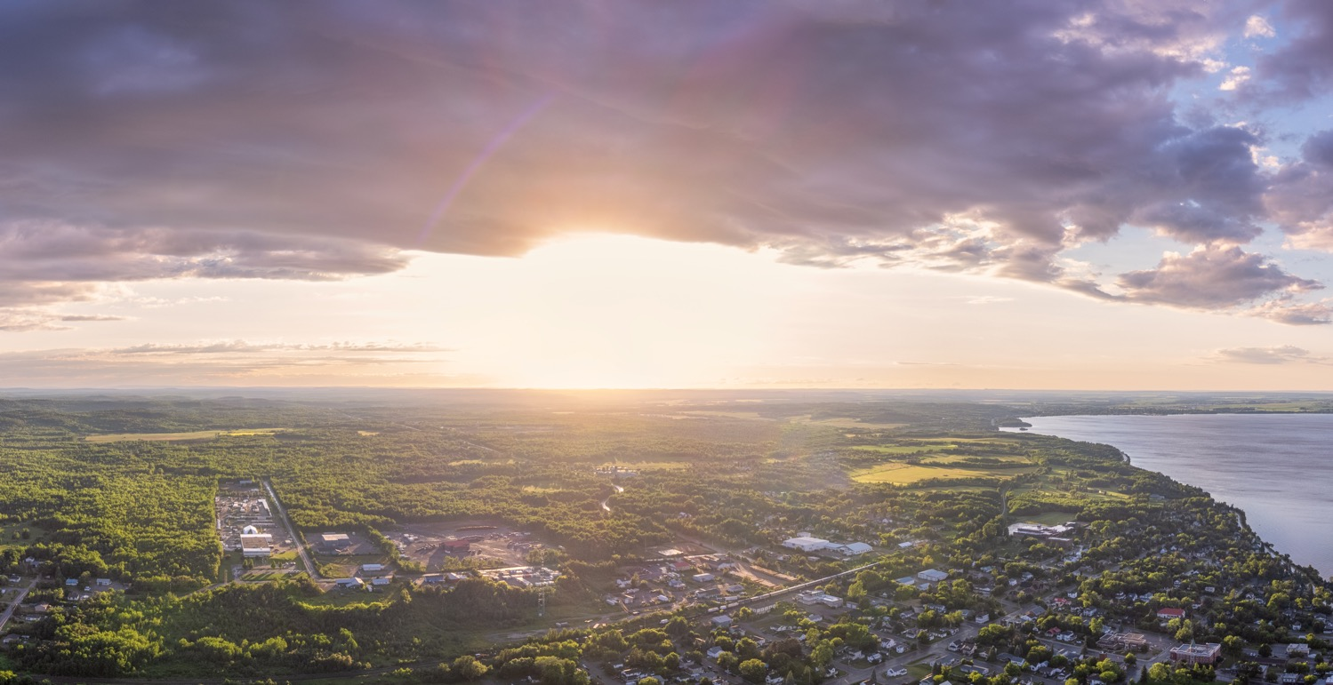
Top 10. New assessment in Northwestern Ontario in 2023
1
Thunder Bay
$54,894,000
5
Shuniah
$7,425,500
9
Sioux Narrows-Nestor Falls
$2,687,600
2
Oliver-Paipoonge
$16,448047
6
Sioux Lookout
$5,023,800
10
Emo
$2,428,000
3
Kenora
$8,808,500
7
Chapple
$3,607,000
4
Greenstone
$8,347,100
8
Neebing
$3,545,500

Slide 9
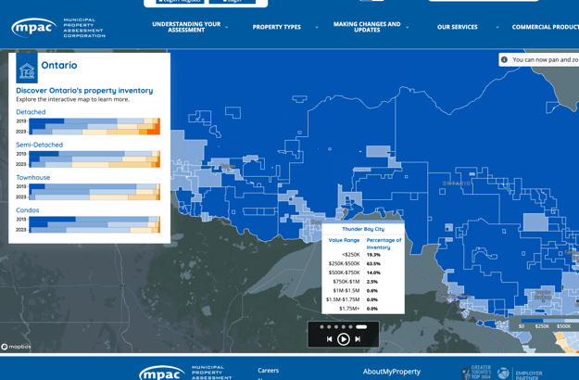
Northern Insights.
Ontario’s residential property landscape
% of total housing inventory below $250k
 | 2013 | 2023
North Bay | 59% | 8%
Timmins | 85% | 55%
Sudbury | 60% | 12%
Sault Ste. Marie | 82% | 36%
Thunder Bay | 71% | 33%
All northern offices | 71% | 29%

Slide 10
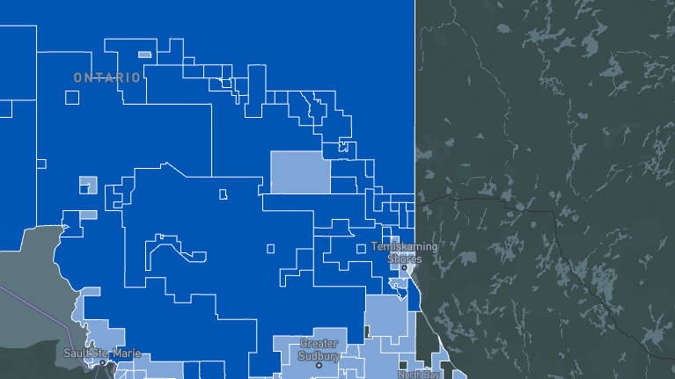
Northern Insights Top 5.
Municipalities with the greatest change
% of total housing inventory below $250k
 | 2013 | 2023
Oliver Paipoonge Municipality | 39% | 3%
O’Connor Township | 74% | 10%
Shuniah Municipality | 38% | 6%
Alberton Township | 70% | 14%
Conmee Township | 76% | 18%

Slide 11
Northern Insights Top 5.
Municipalities with the least change
% of total housing inventory below $250k
 | 2013 | 2023
Manitouwadge Township | 99.8% | 98%
Pickle Lake Township | 98% | 93%
Atikokan Township | 99% | 94%
Hornepayne Township | 99.7% | 92%
Terrace Bay Township | 99.7% | 90%

Slide 12
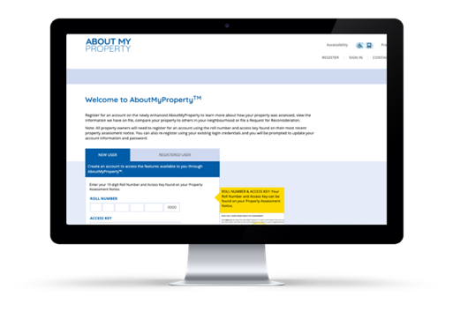
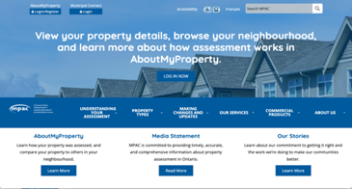
Supporting property owners and municipalities. Resources, tips and more on mpac.ca
AboutMyPropertyTM
Educational videos
Orientation Sessions
Conferences
Municipal Resources + Property Assessment Toolkit
Municipal Connect
InTouch Newsletter
Door
hangers + letters
NEW! First-time Homeowners’ Hub
Social media
campaigns

Slide 13
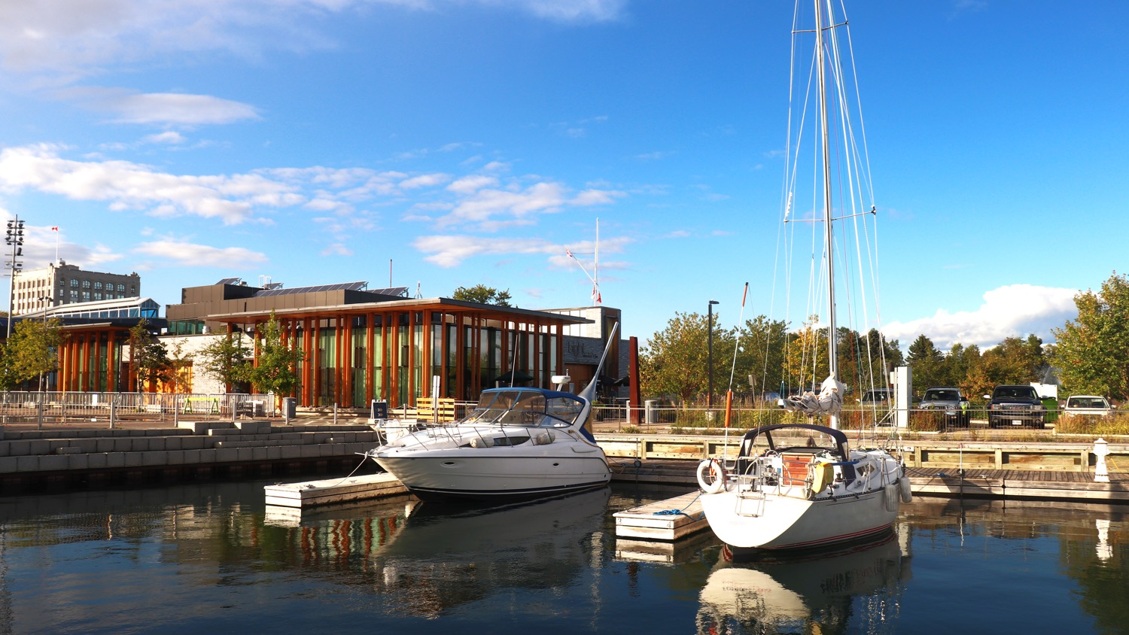
Thank you.

